Slide 1
Dimensional Modelling from A - Z
Arthur Graus

Slide 2



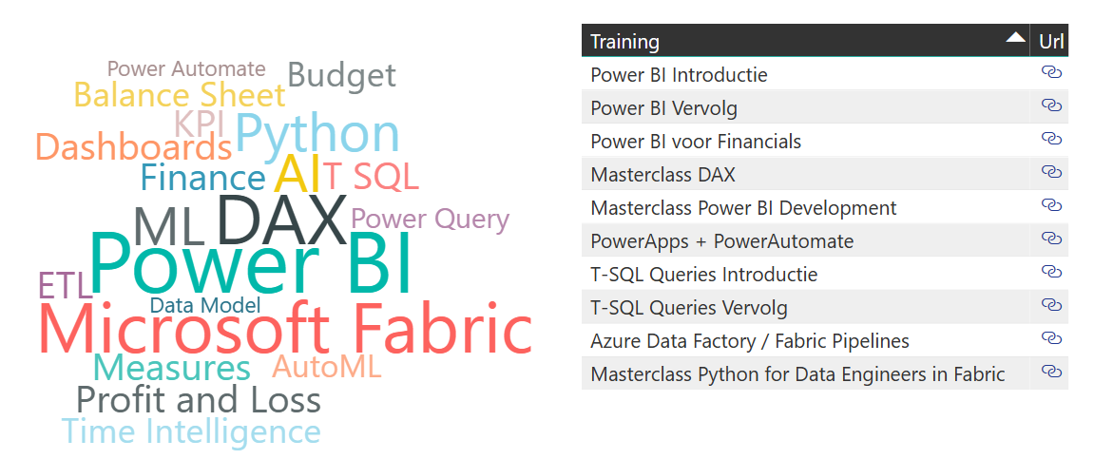

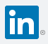
Bio: Arthur Graus
Power BI + MS Fabric Trainer | Developer / ML Enthusiast
Questions, re
info@arthurgraus.nl
https://www.linkedin.com/in/arthurgraus

Slide 3
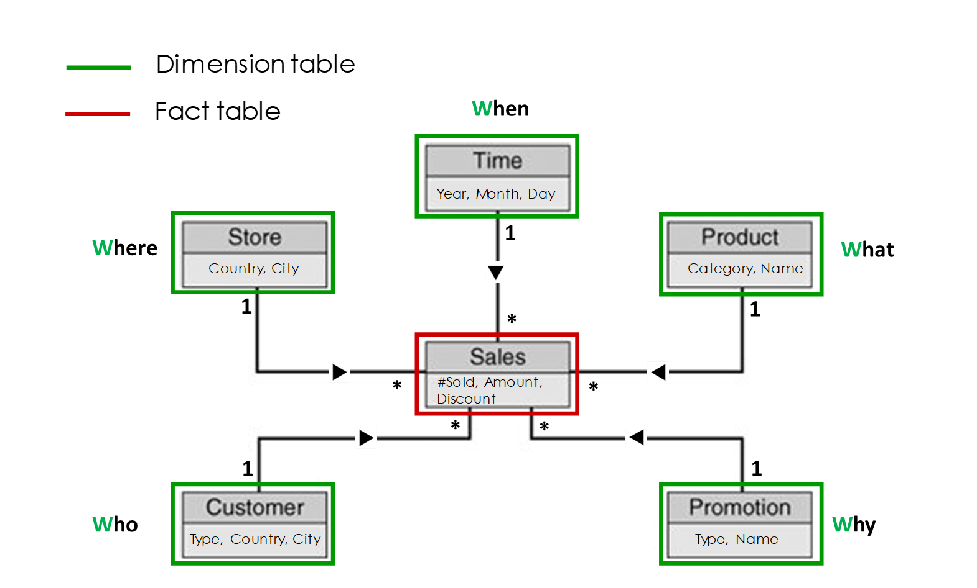
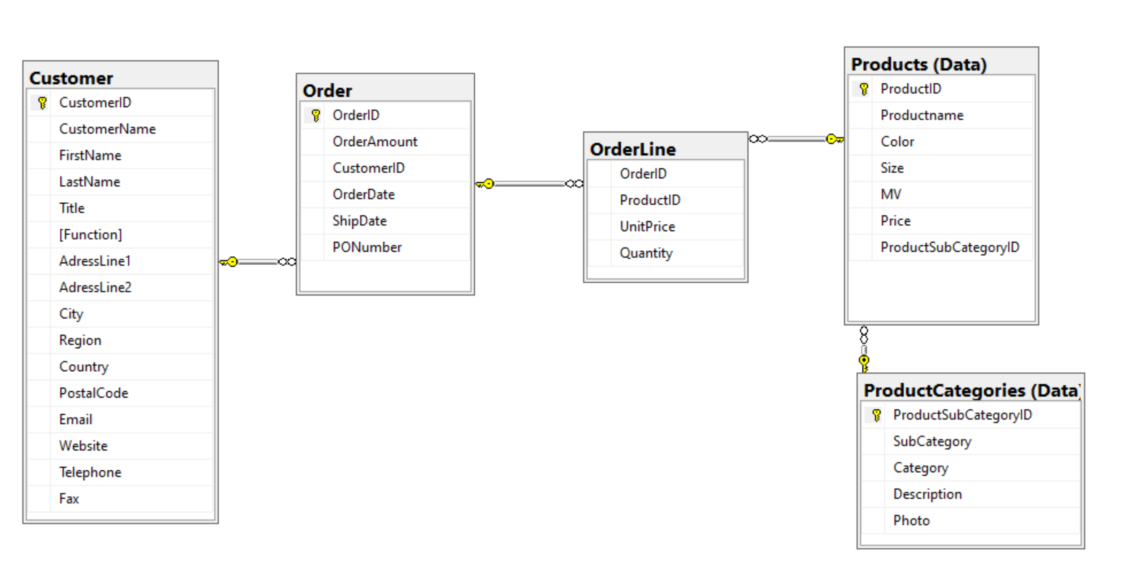
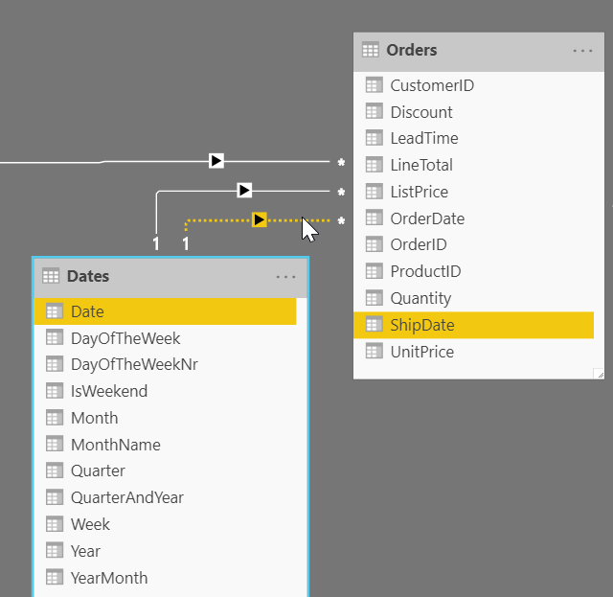
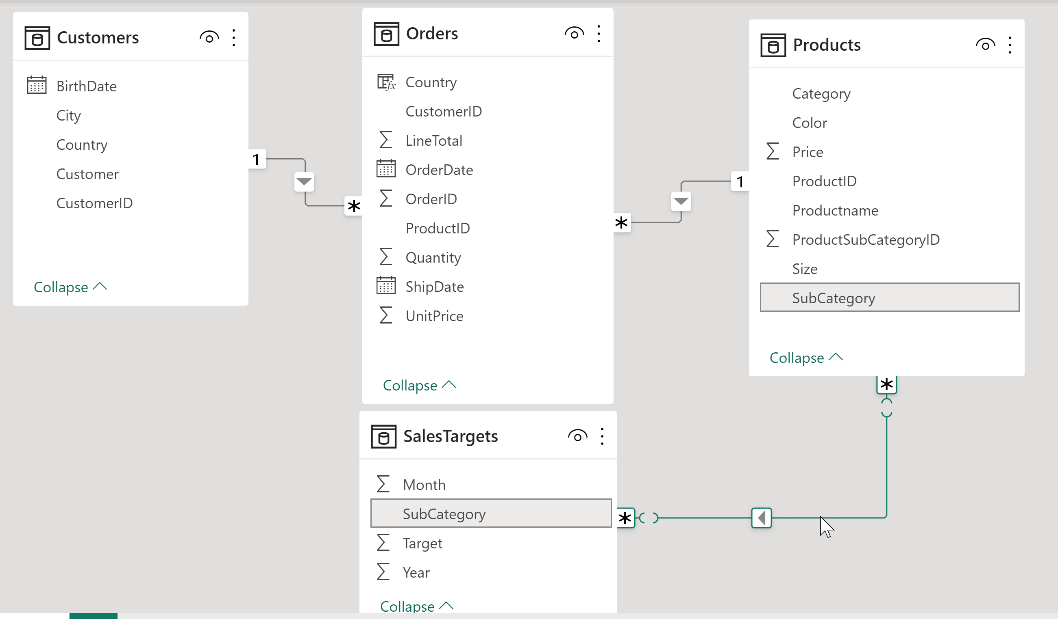
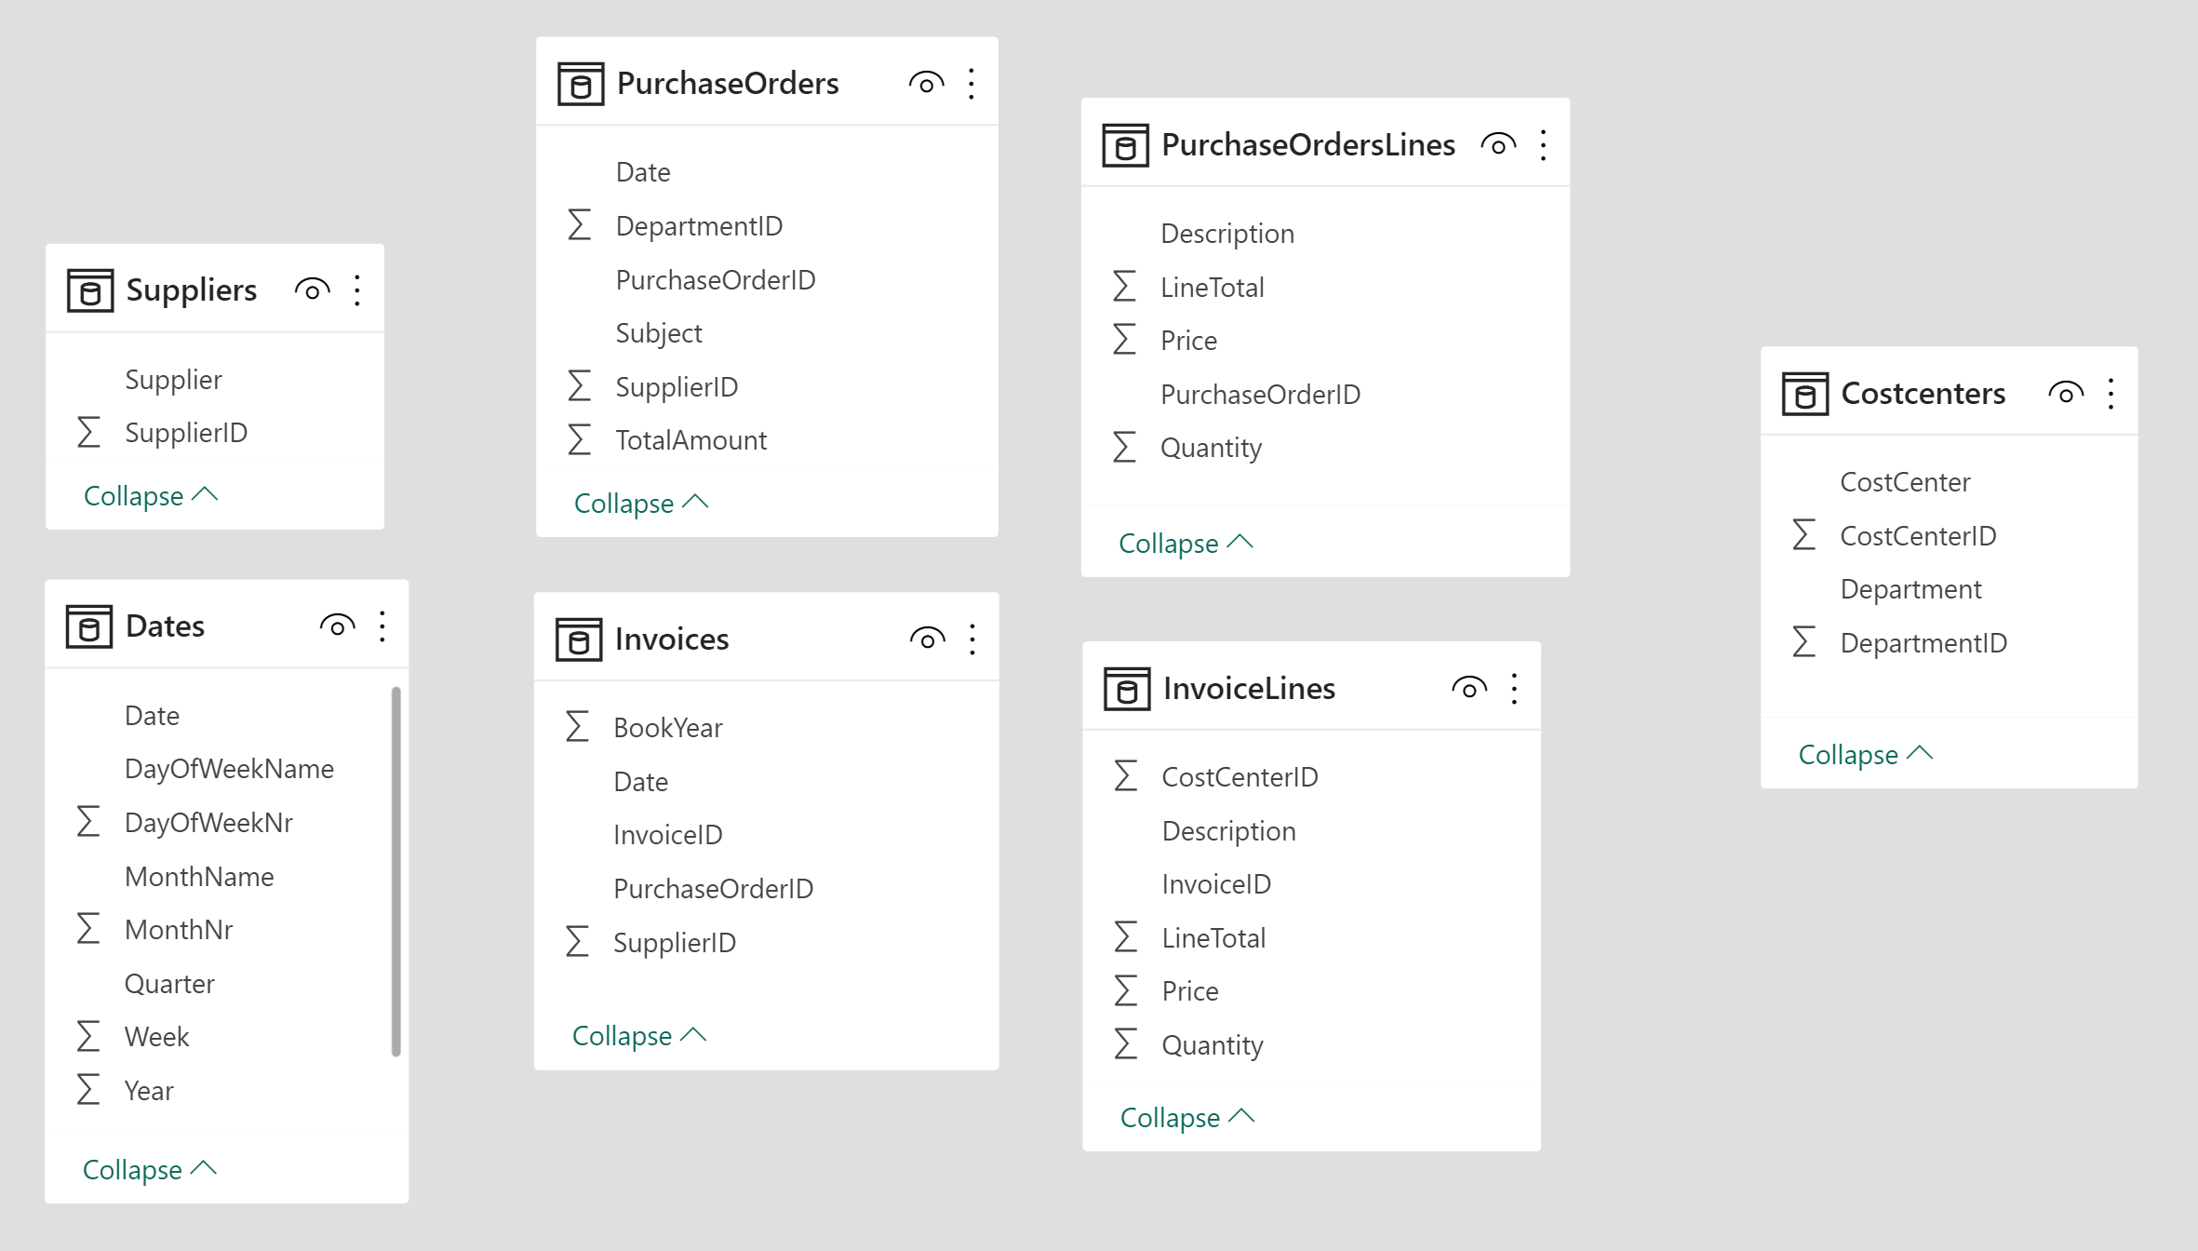
Table of contents
01: Introduction
02: Relational -> Dimensional
03: Many to many
04: Date table
05: Cross Filter Direction
06: Master-detail tables
07: Inactive relationships
08: Slowly Changing Dimensions
09: Import v.s. Direct Query
10: Vertipaq Engine

Slide 4
01: Introduction

Slide 5
Overview - Technical BI: ETL + SQL Server BI Architecture
For more information about Datawarehouses, click here.

Slide 6

Star schema = User friendly database design for reporting
When
1
Where
What
1
1
*
*
*
*
*
1
1
Who
Why
For more information about Star schema's, click here.

Slide 7
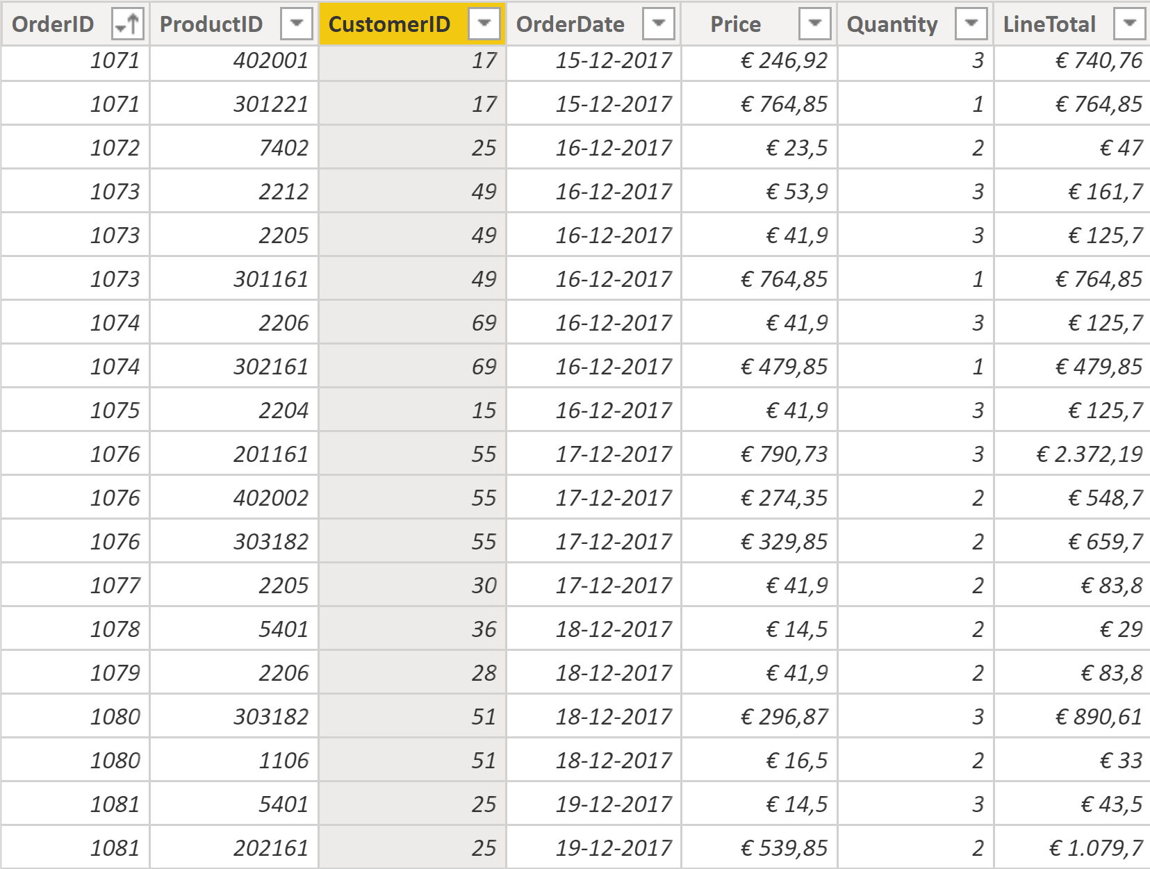
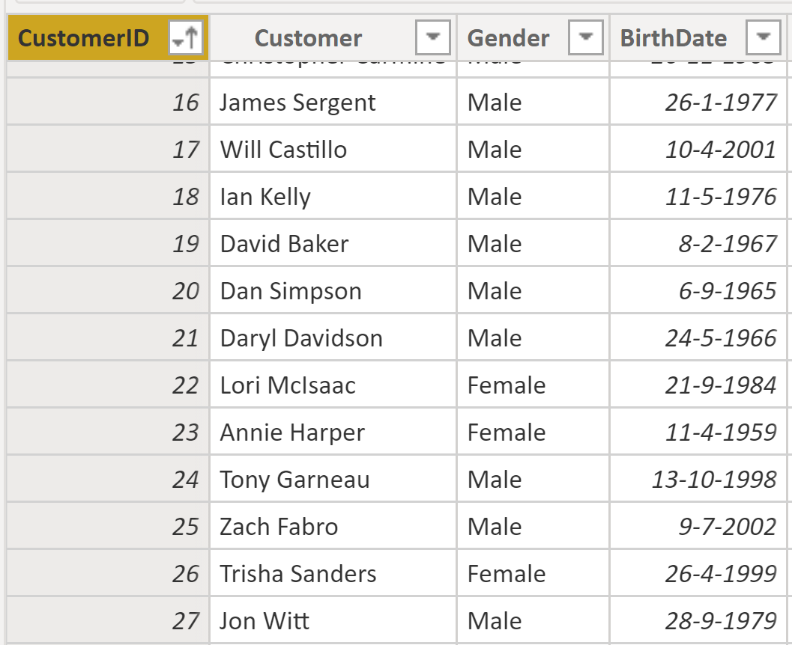
1 to many (*) relationship
many (*)
1

Slide 8
Fact v.s. Dimension table: Summary
Fact table:
Contains Values / facts that can be aggregated like: Revenue, Quantity, Price, Discount, # of Hours etc.
Is on the many side of the relationship.
Has a date column: date, year, quarter, month, week etc.
Examples:
Sales: Orders, Invoices, Product Prices, Sales Targets
Finance: Financial Transactions, Budgets, Forecasts, Profit & Loss
HR: FTE, Sick leave, Salary, Worker inflow/outflow
Project Management: TimeTracking, Budgets, Issues, Planning
Production: Production, Stock, Incidents, Measurements, Leadtimes
Dimension table:
Contains columns / entities you want to use for filtering, grouping and sorting.
Is on the one side of the relationship.
Examples:
Sales: Products, Customers, Stores, Regions, Accountmanagers, Resellers
Finance: CostCentres, LedgerAccounts, Business Units
HR: Employees, Functions, Departments, Managers
Project Management: Projects, Project Leads, Project Members
Production: Machines, Production Lines, Operators, Sensors, Parts

Slide 9
Demo - OLAP Cube / SQL Server Analysis Services Model

Slide 10
02: Relational -> Dimensional

Slide 11
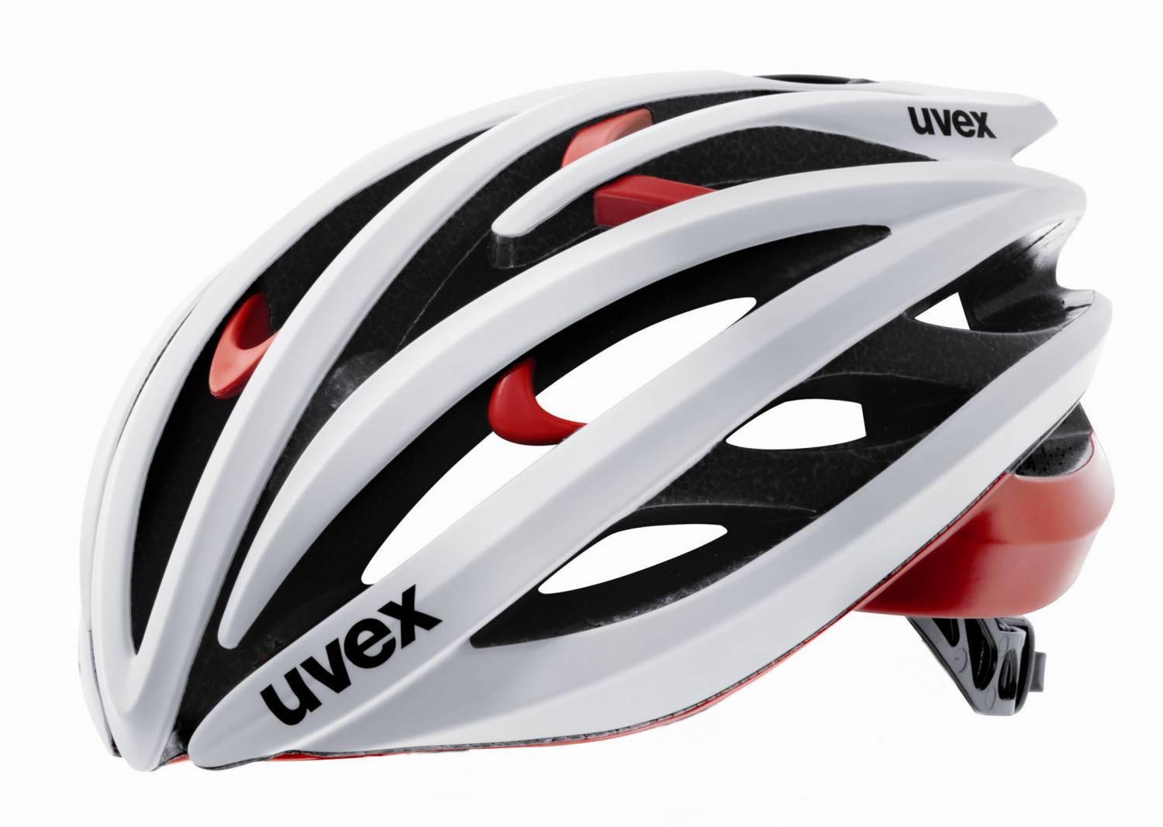
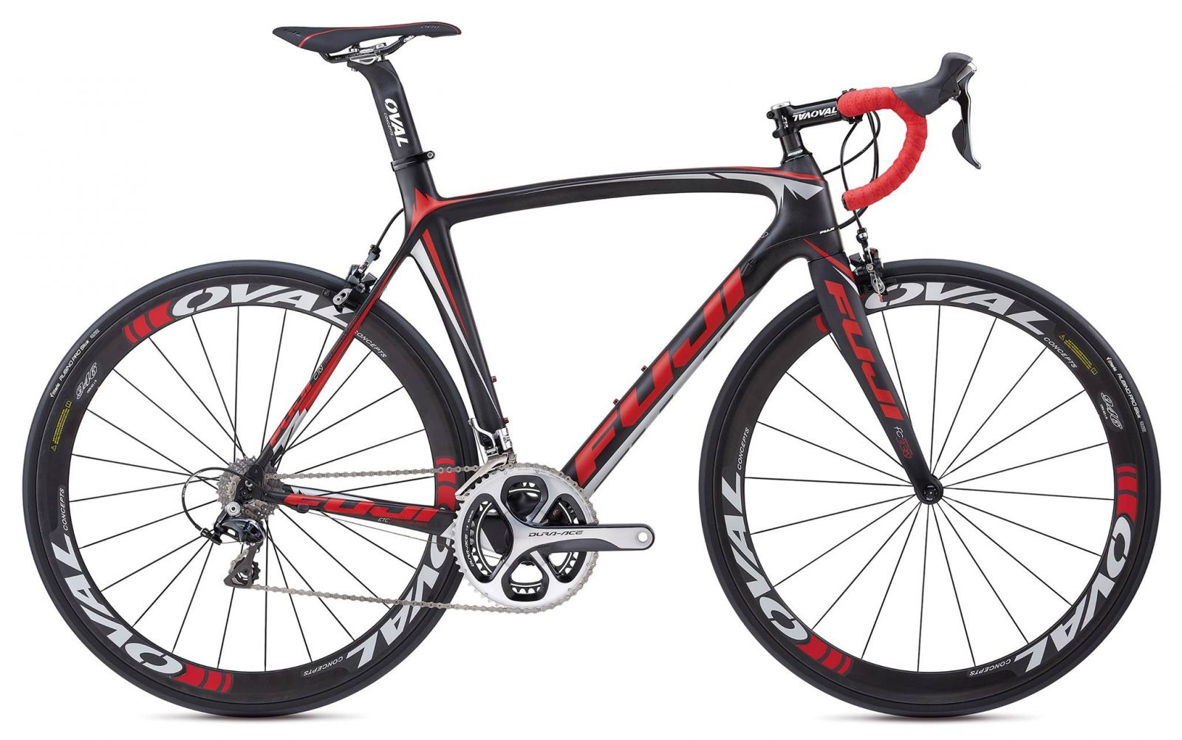

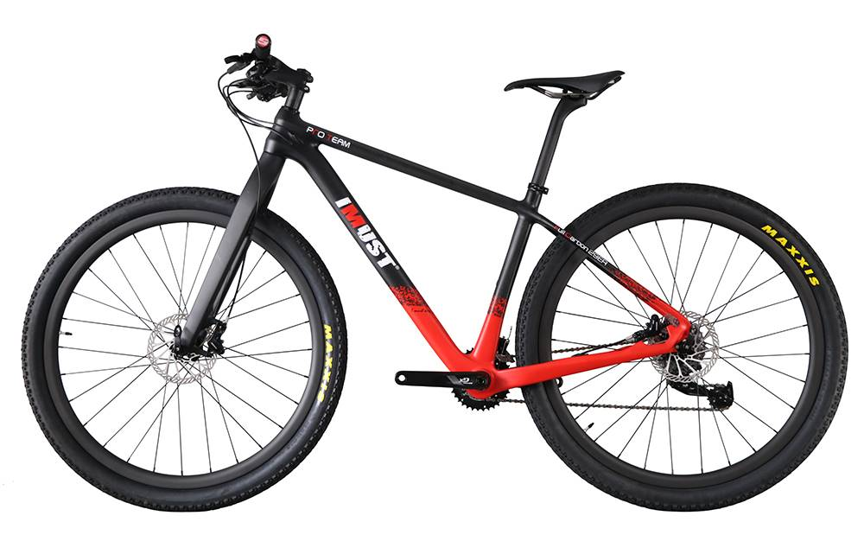
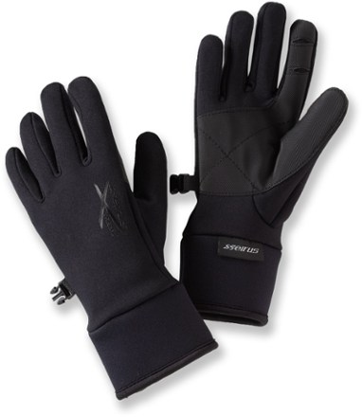
Challenge: Convert Relational to Star (Fact + Dimensions)
Xtreme is a fictitious company that sells bicycles and cycling accessories.

Slide 12
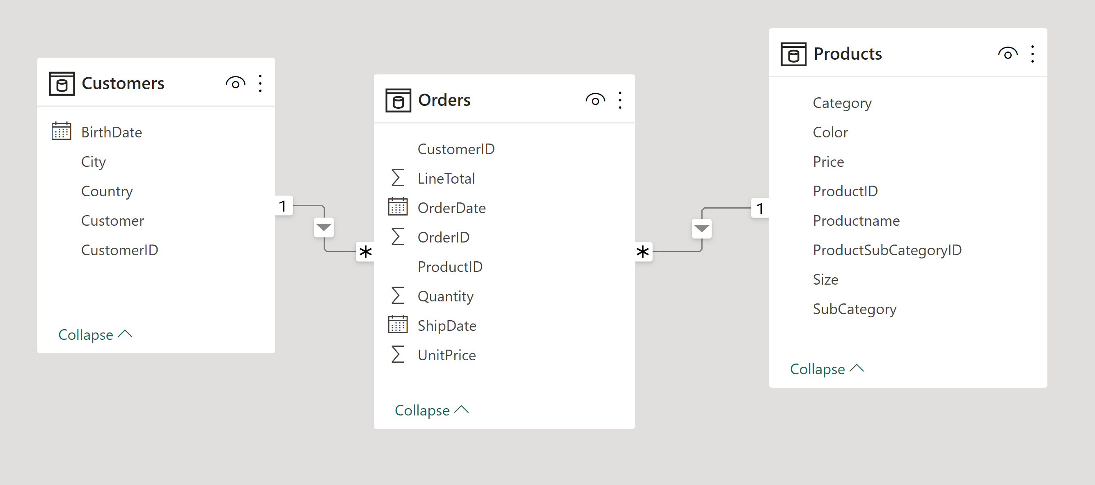
Demo: Relational to Star schema

Slide 13
03: Many to many relationships

Slide 14
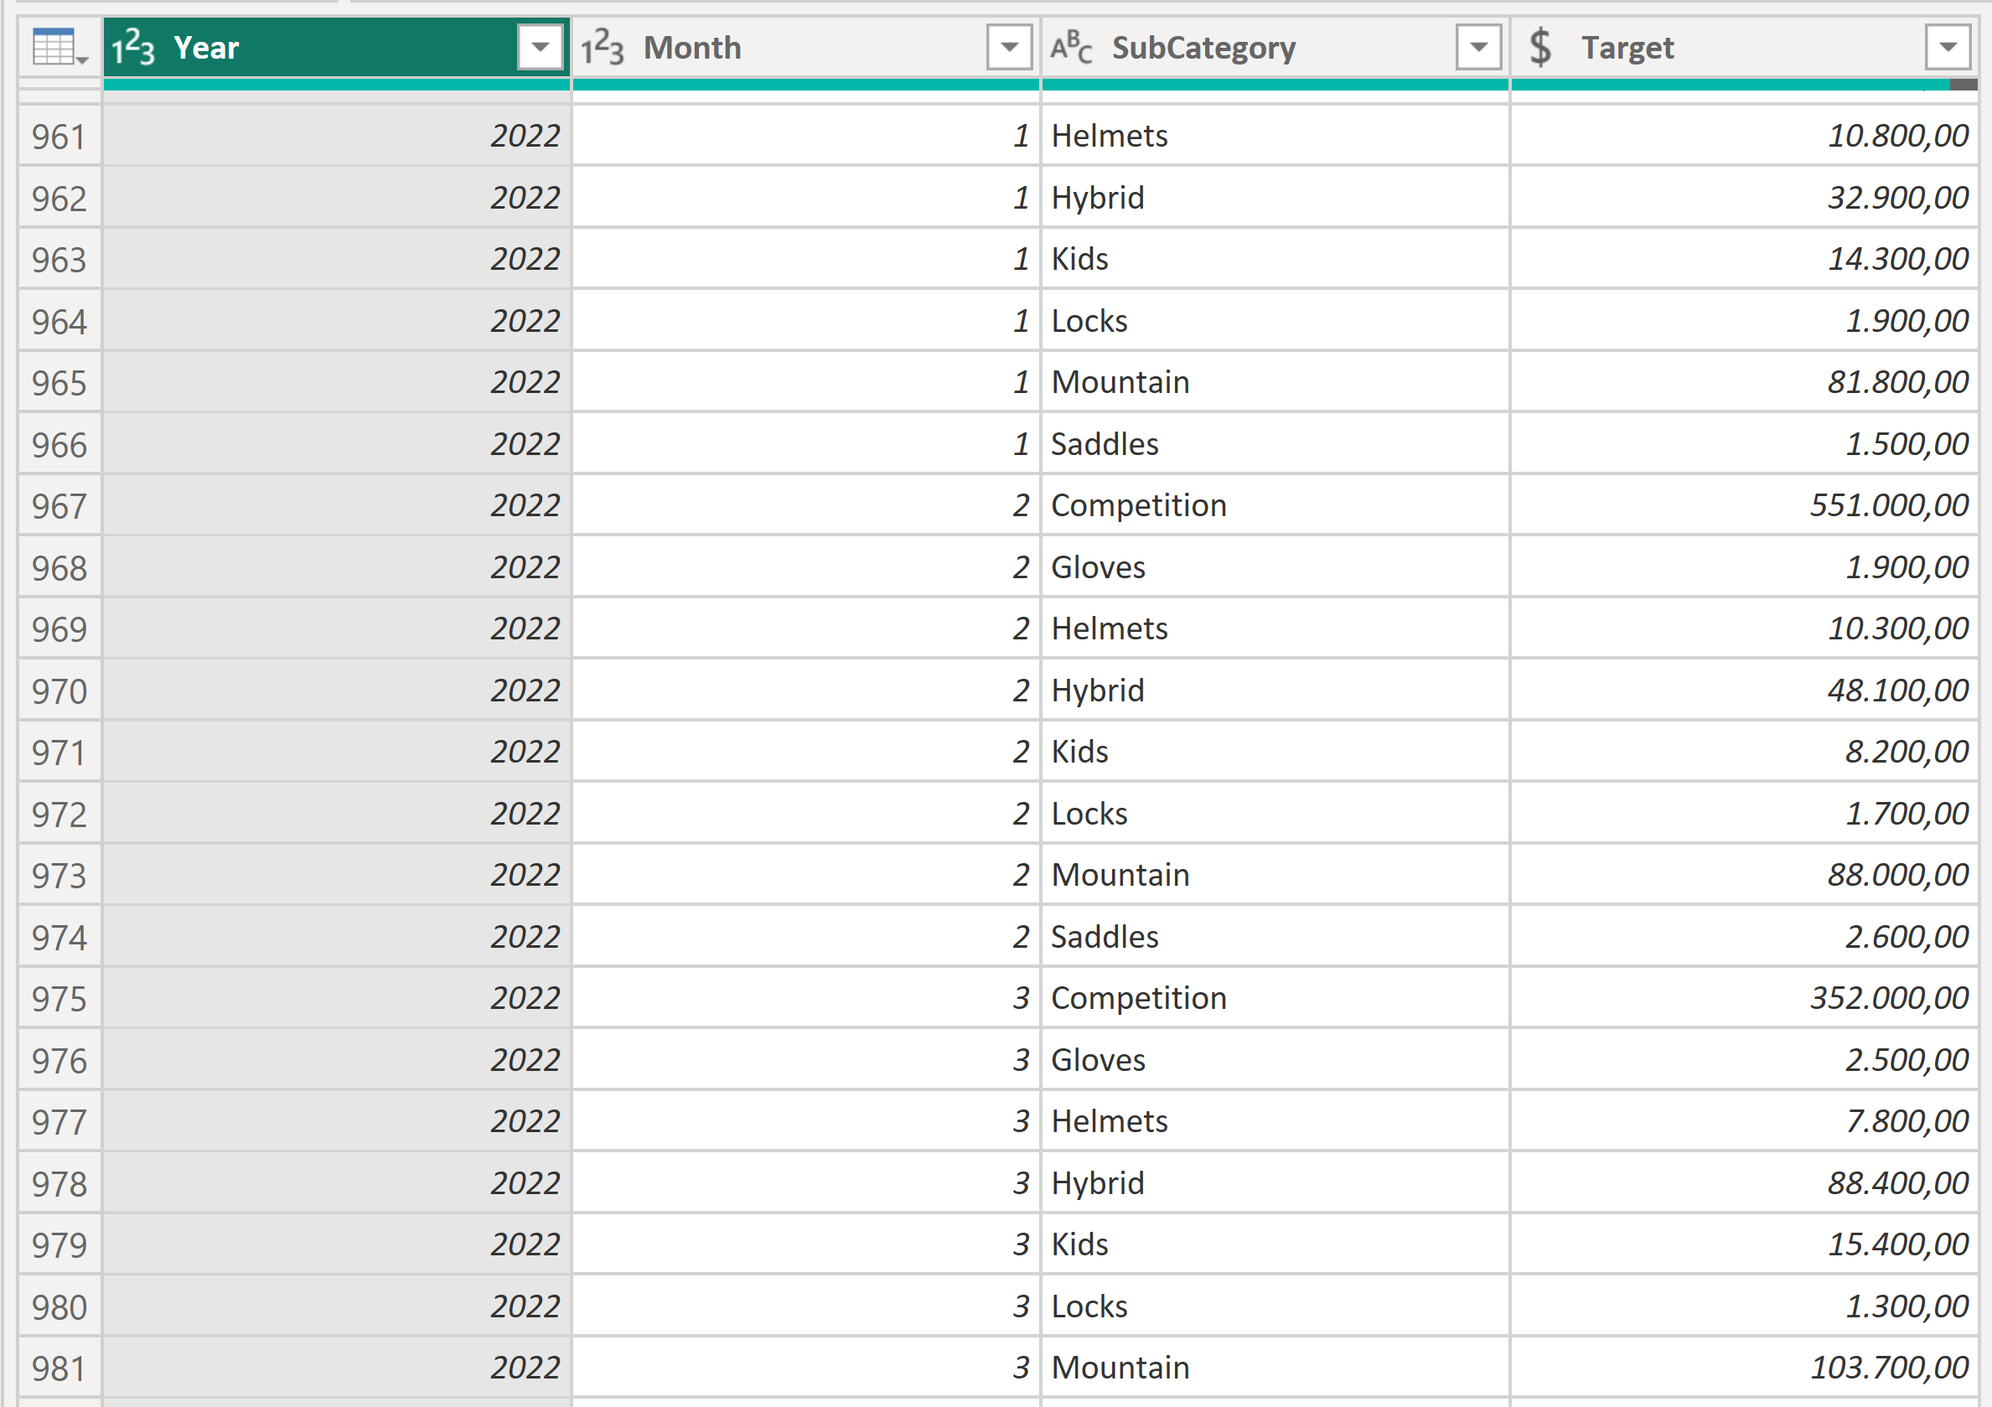
Sales Targets

Slide 15
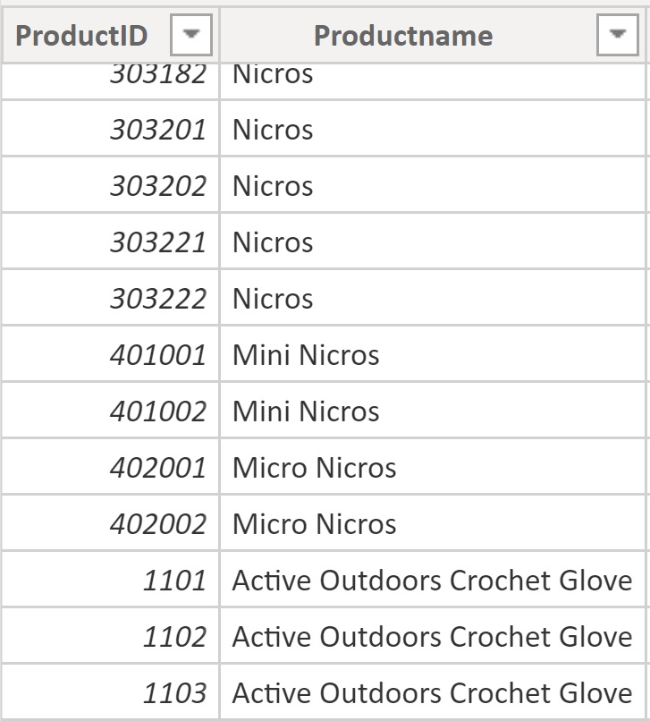
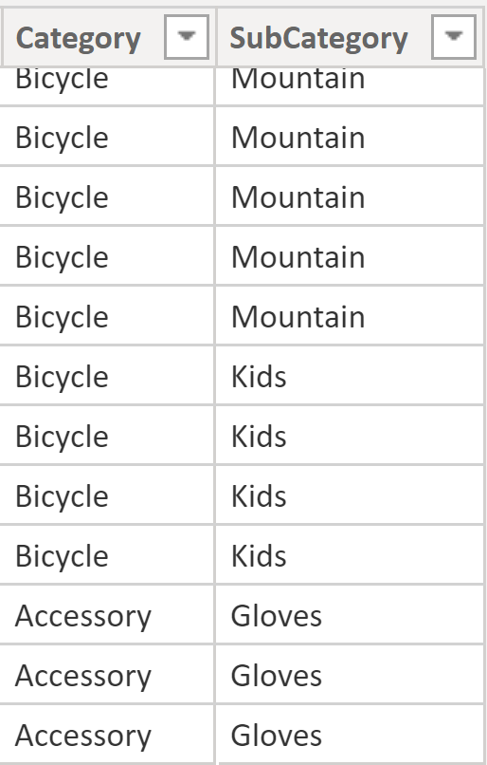
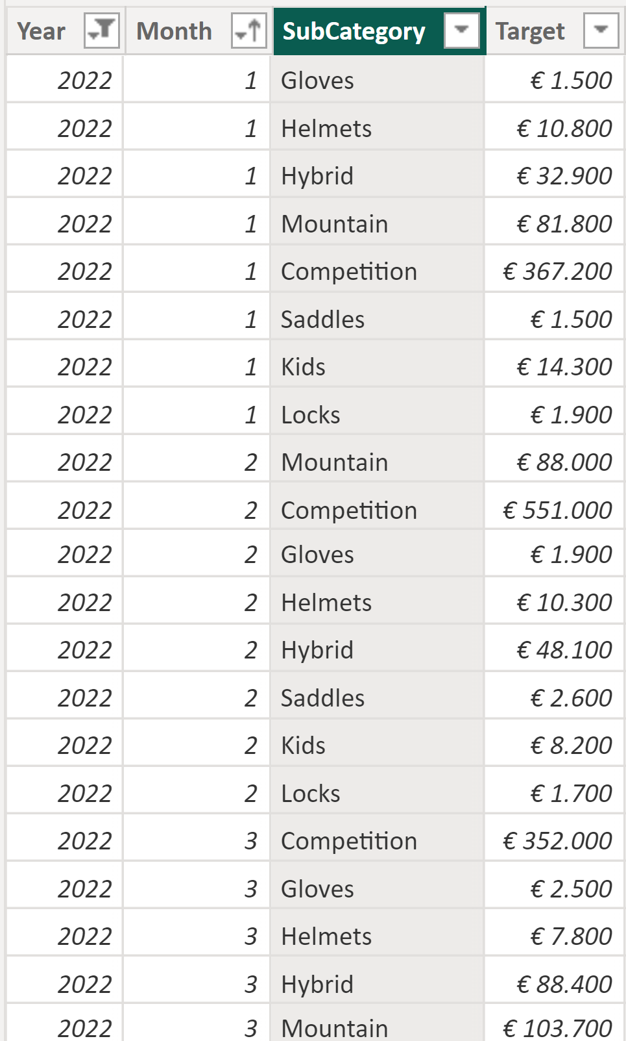
Many to Many relationship
many (*)
many (*)

Slide 16
Overview - Many to Many relationship
Only between Dimension and Fact tables and filter direction from Dimension to Fact!
For more information about Many to Many Relationships, click here.

Slide 17
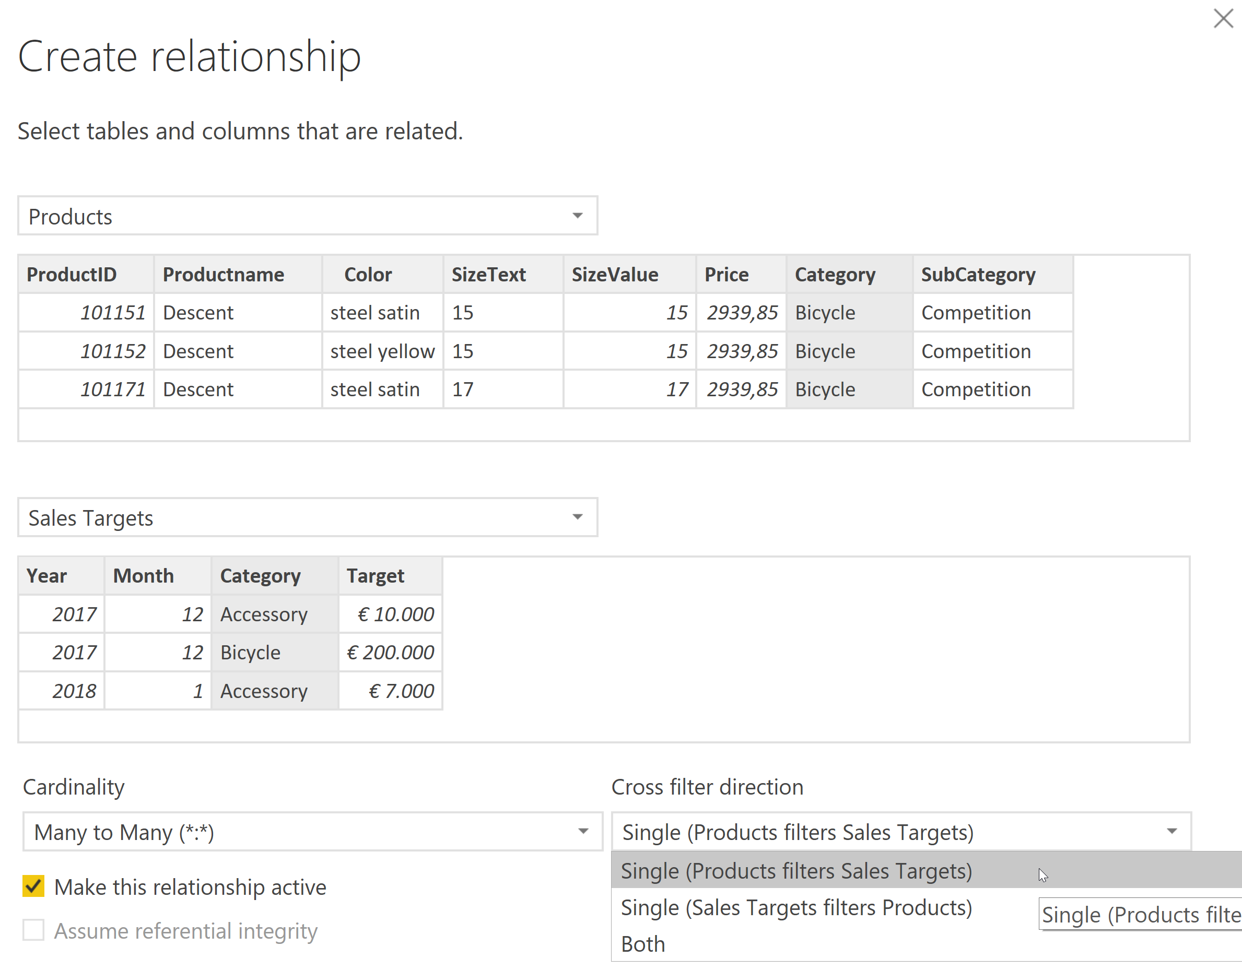
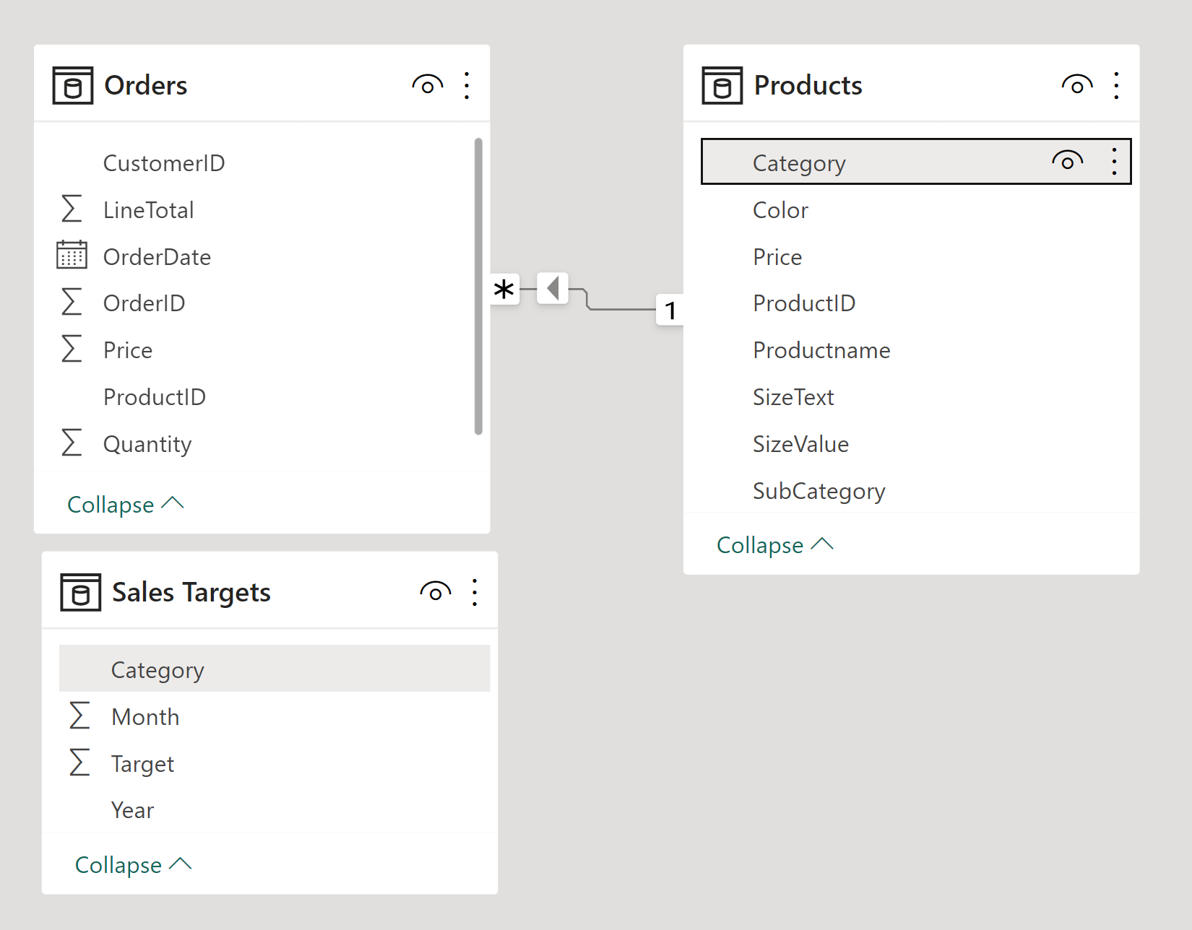
Demo - Many to Many relationship
1A
1B
3
2

Slide 18

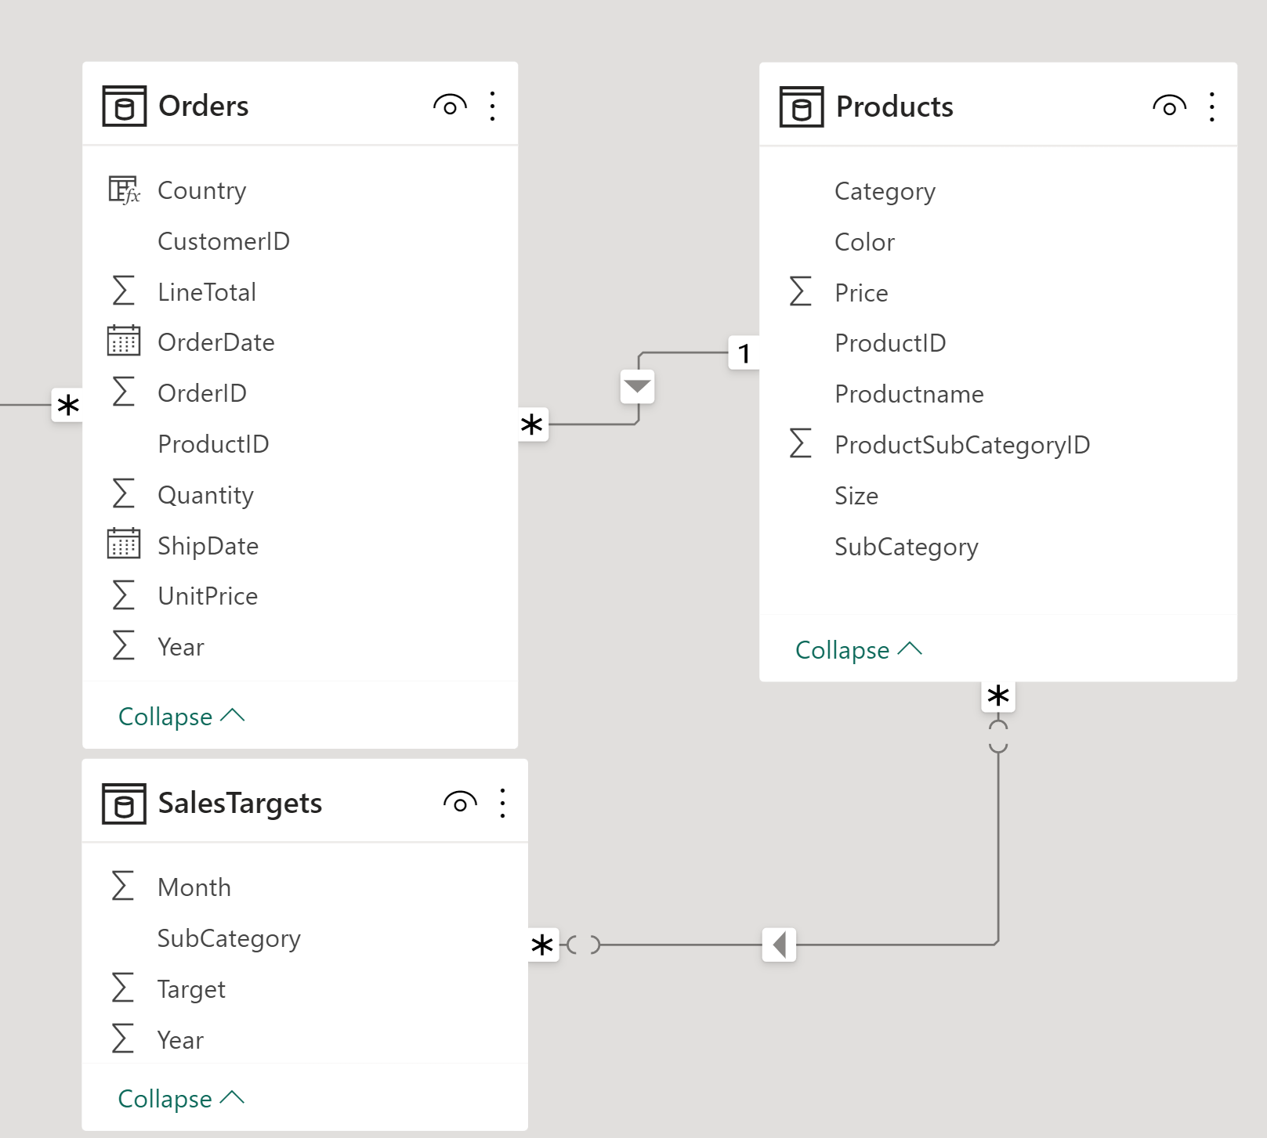
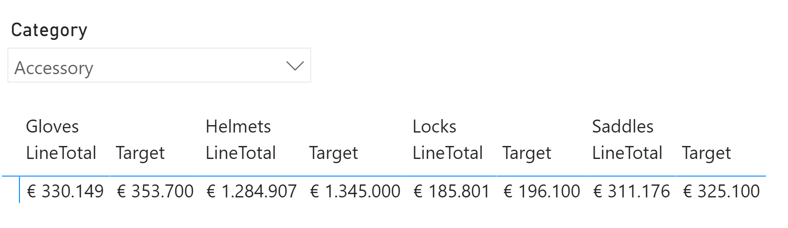
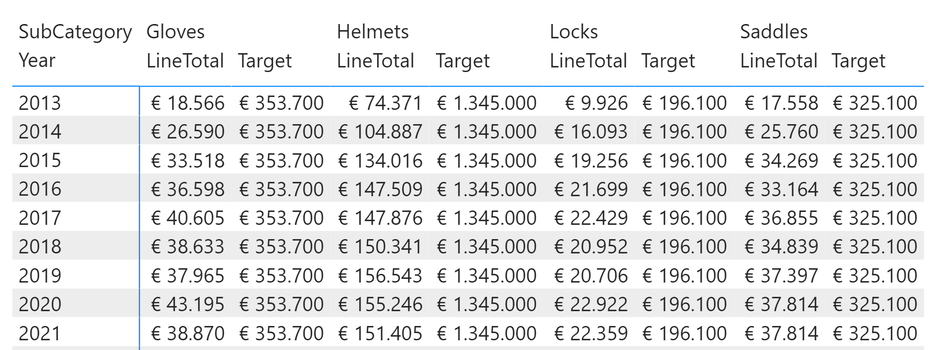
Challenge: Connect Fact tables
How to compare actual + targets per year?

Slide 19
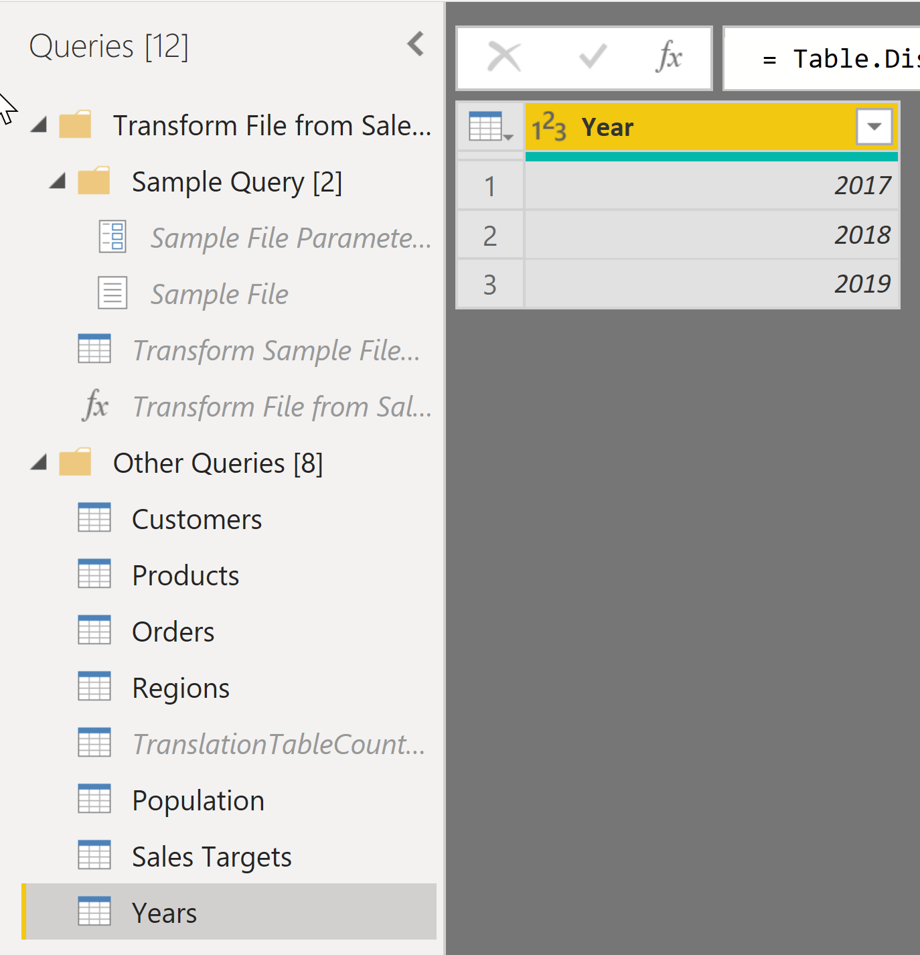
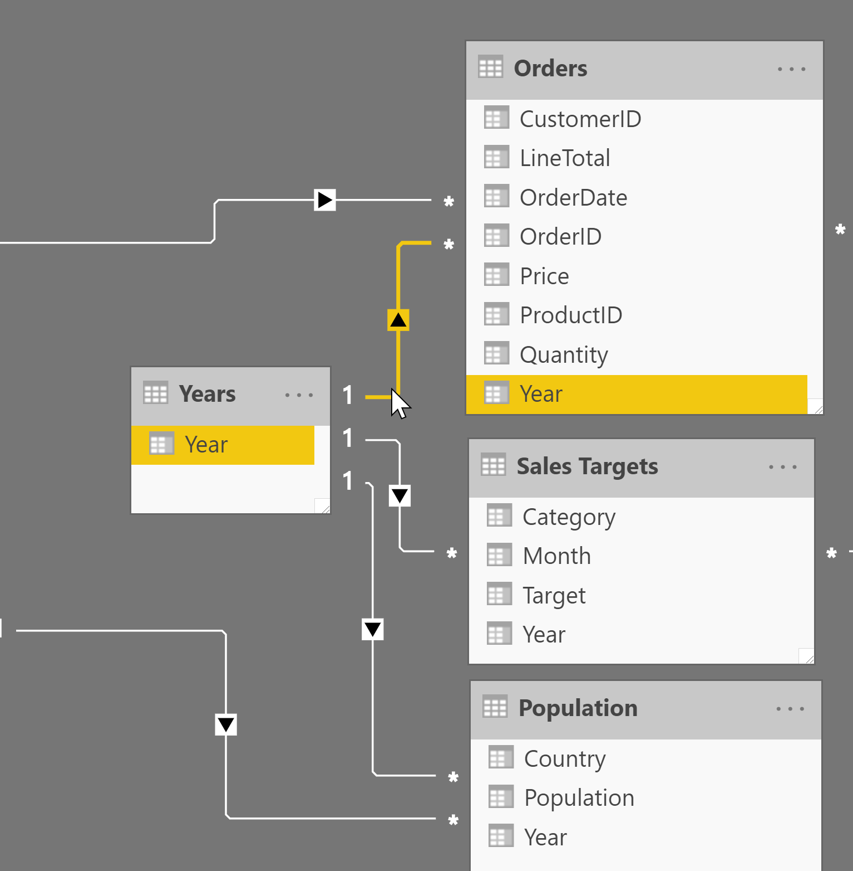
Demo: Power Query - Years Table

Slide 20
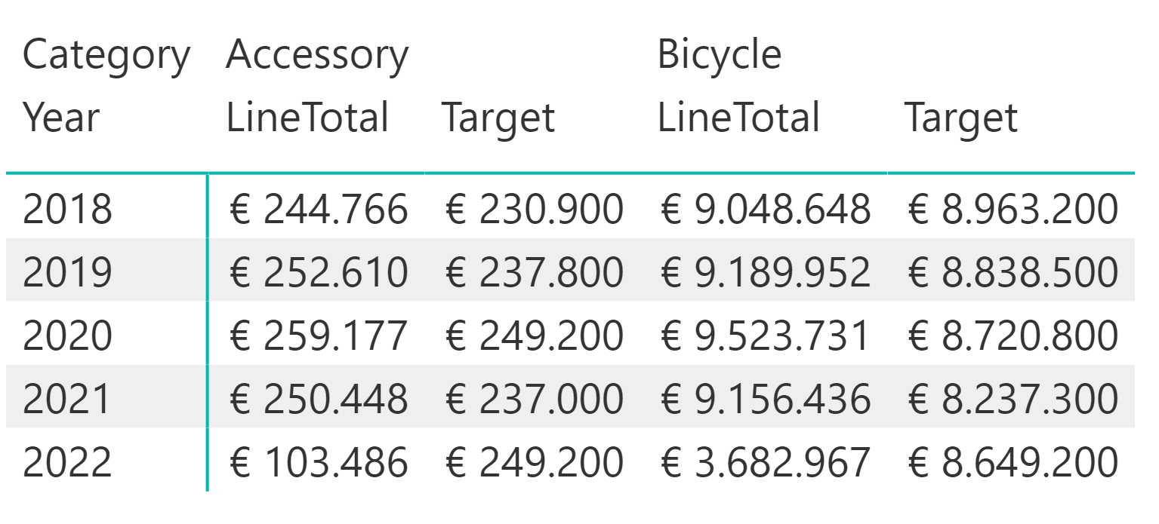
Demo: Report - Create KPI Matrix
Can you also drilldown to the Month level?

Slide 21
04 Date table

Slide 22
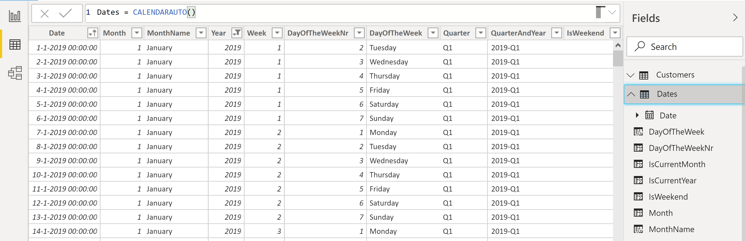
Overview - Date Table
Options for creating a Date Table:
Use DAX functions to manually create a Date table and add calculated columns: CalendarAuto, Month, Format
Apply a ready-to-use DAX-script (see txt-file)
Import a date table from SQL Sever or Excel:
For more information about creating a DAX Date table, click here.

Slide 23
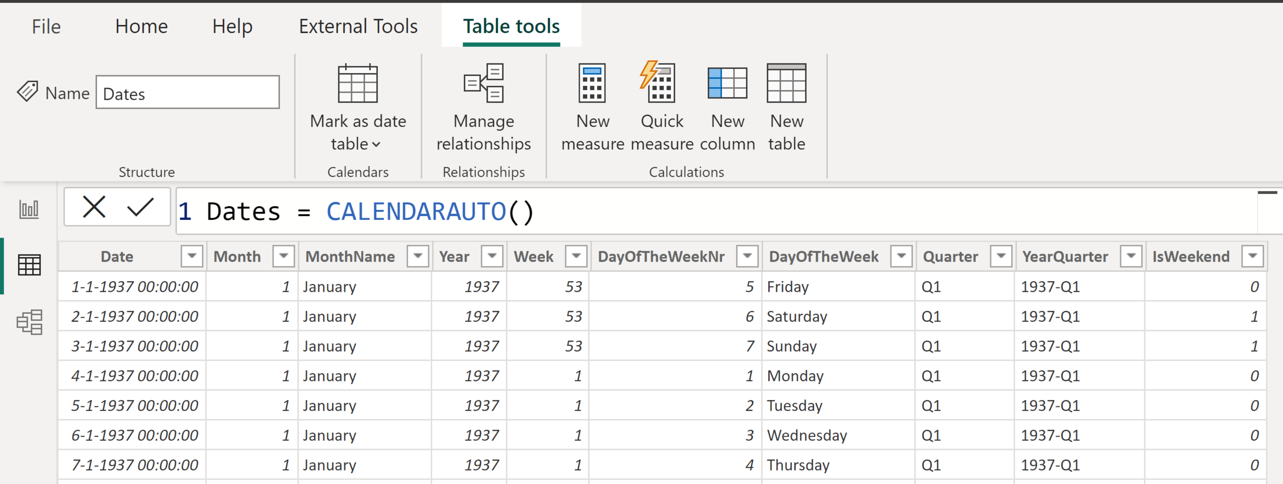
Demo – DAX – Date Table
1
4
2
3

Slide 24
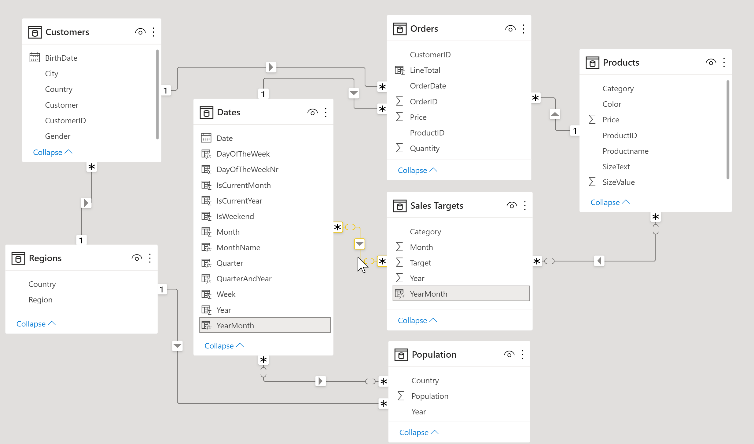
Demo: Relate data table to fact tables

Slide 25
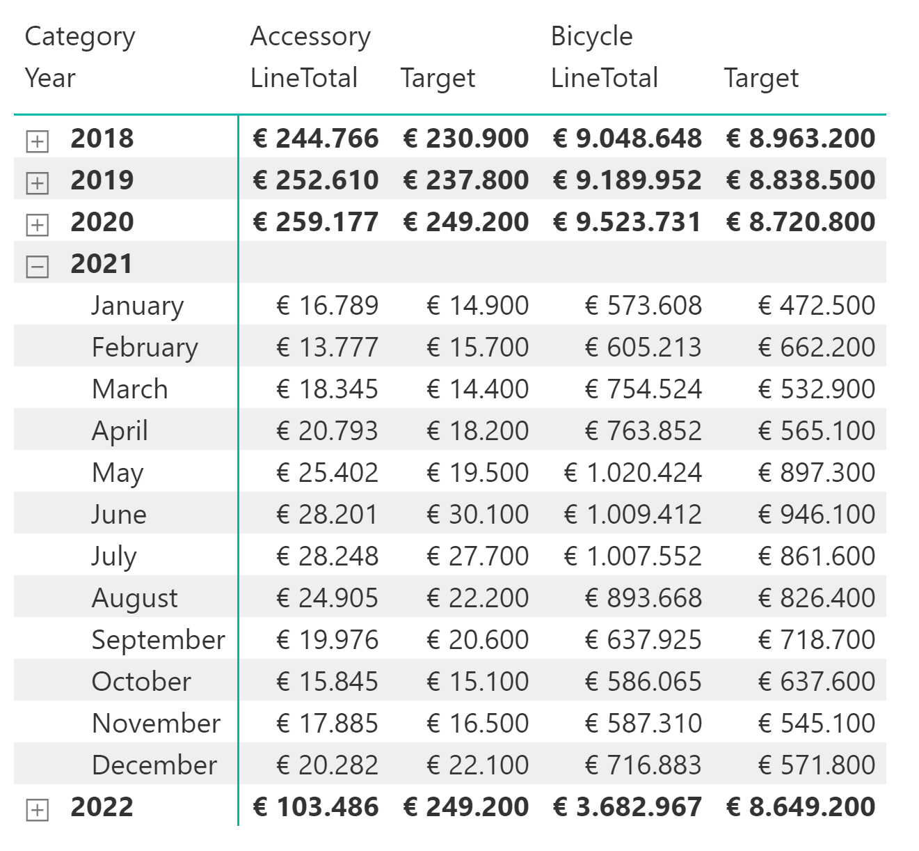
Demo: Report – Relate to Date table fact table
Sort MonthName by MonthNr: https://docs.microsoft.com/en-us/power-bi/desktop-sort-by-column

Slide 26
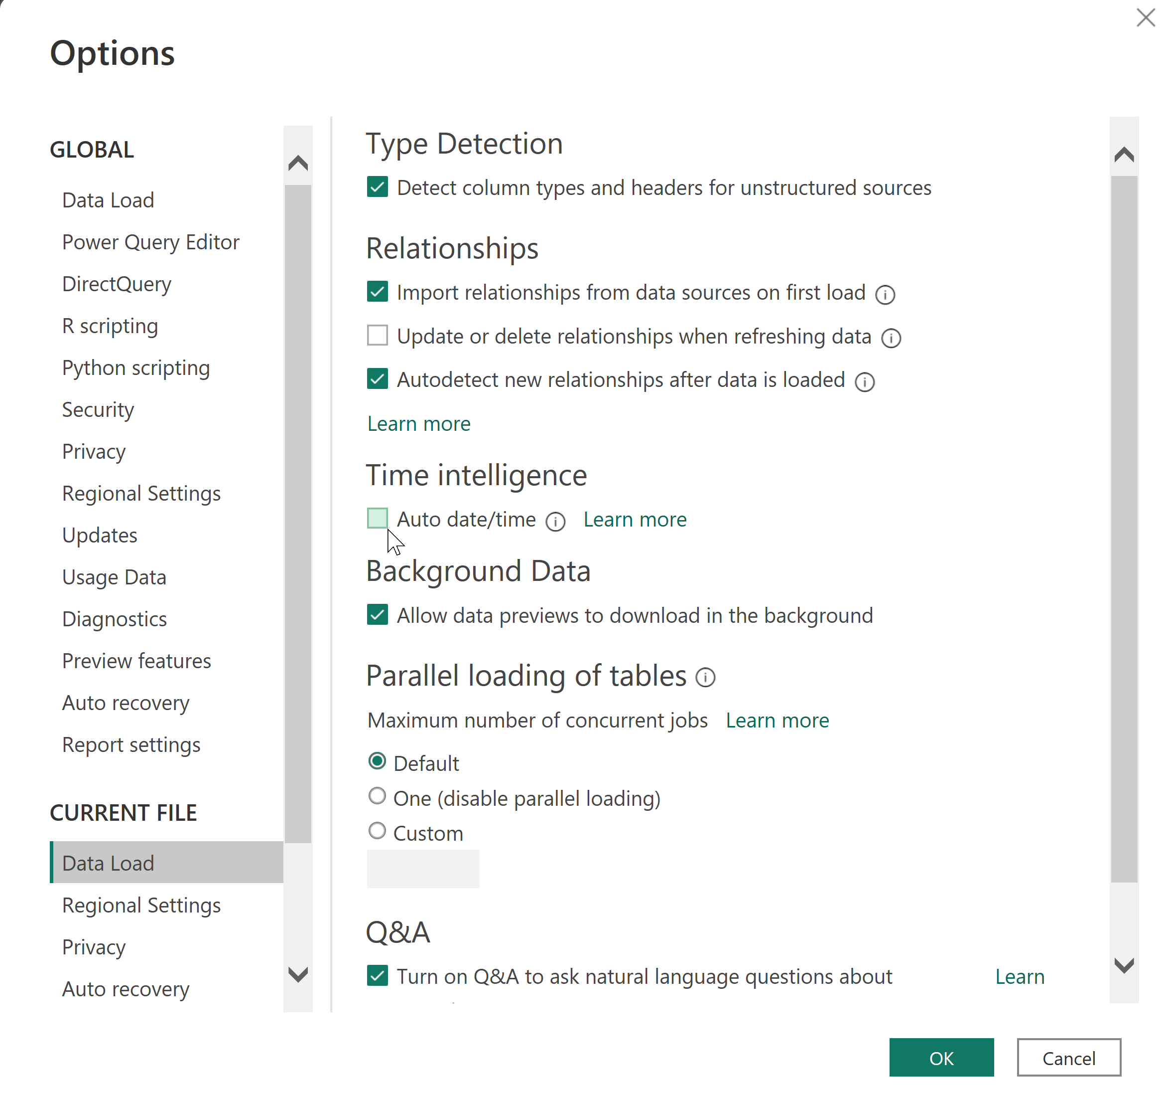
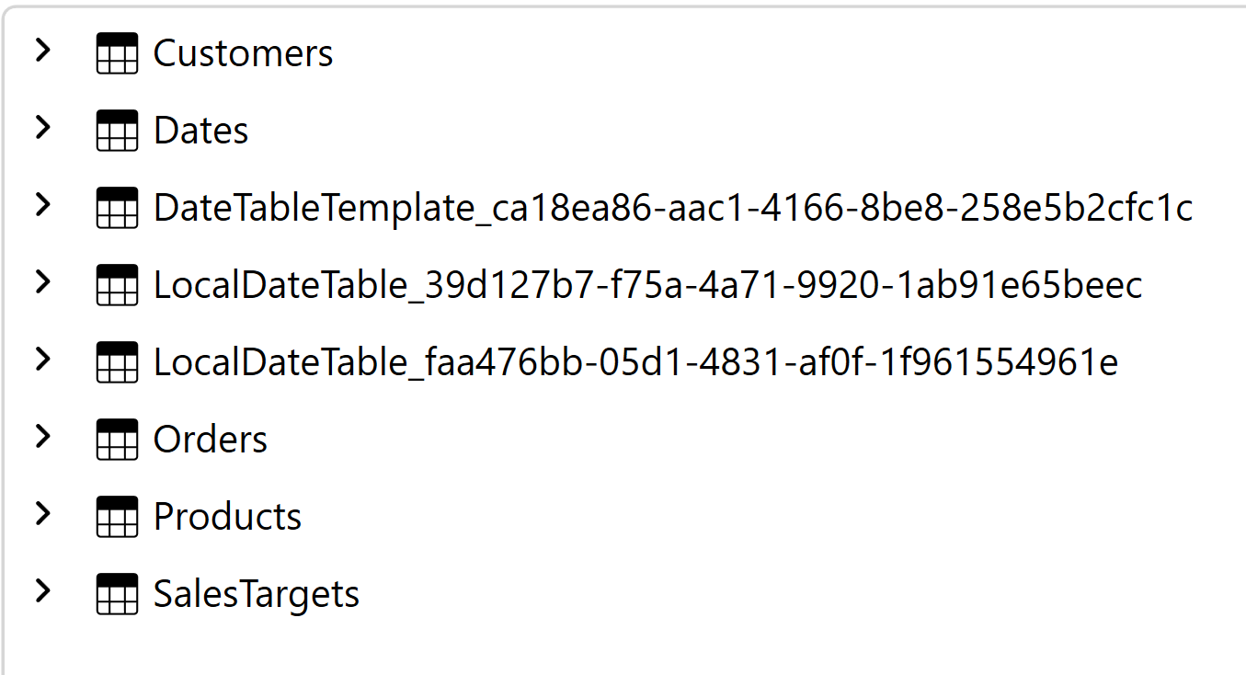
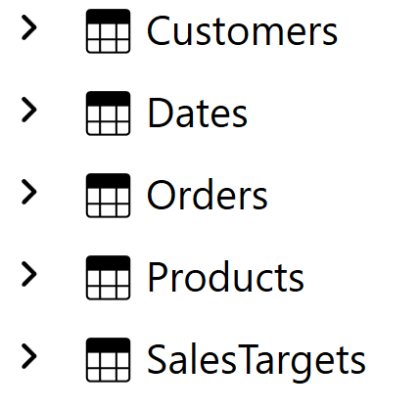
Demo – Disable Auto Date/time Tables
Before
After

Slide 27
05 Cross-Filter Direction

Slide 28
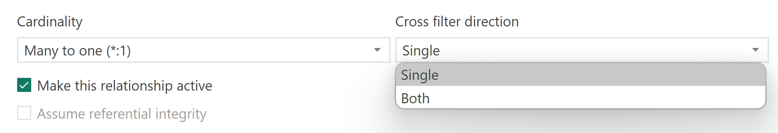
Cross-Filter direction
Single:
Default for One to many
Filter Direction: Dimension -> fact
Best for performance
Both / Bi-directional:
Required for One to one relationships
Between Master-Detail Fact Tables: f.e. PO+ POLines
Can cause ambiguity and slow performance
Do not use with Many to many relationships!

Slide 29
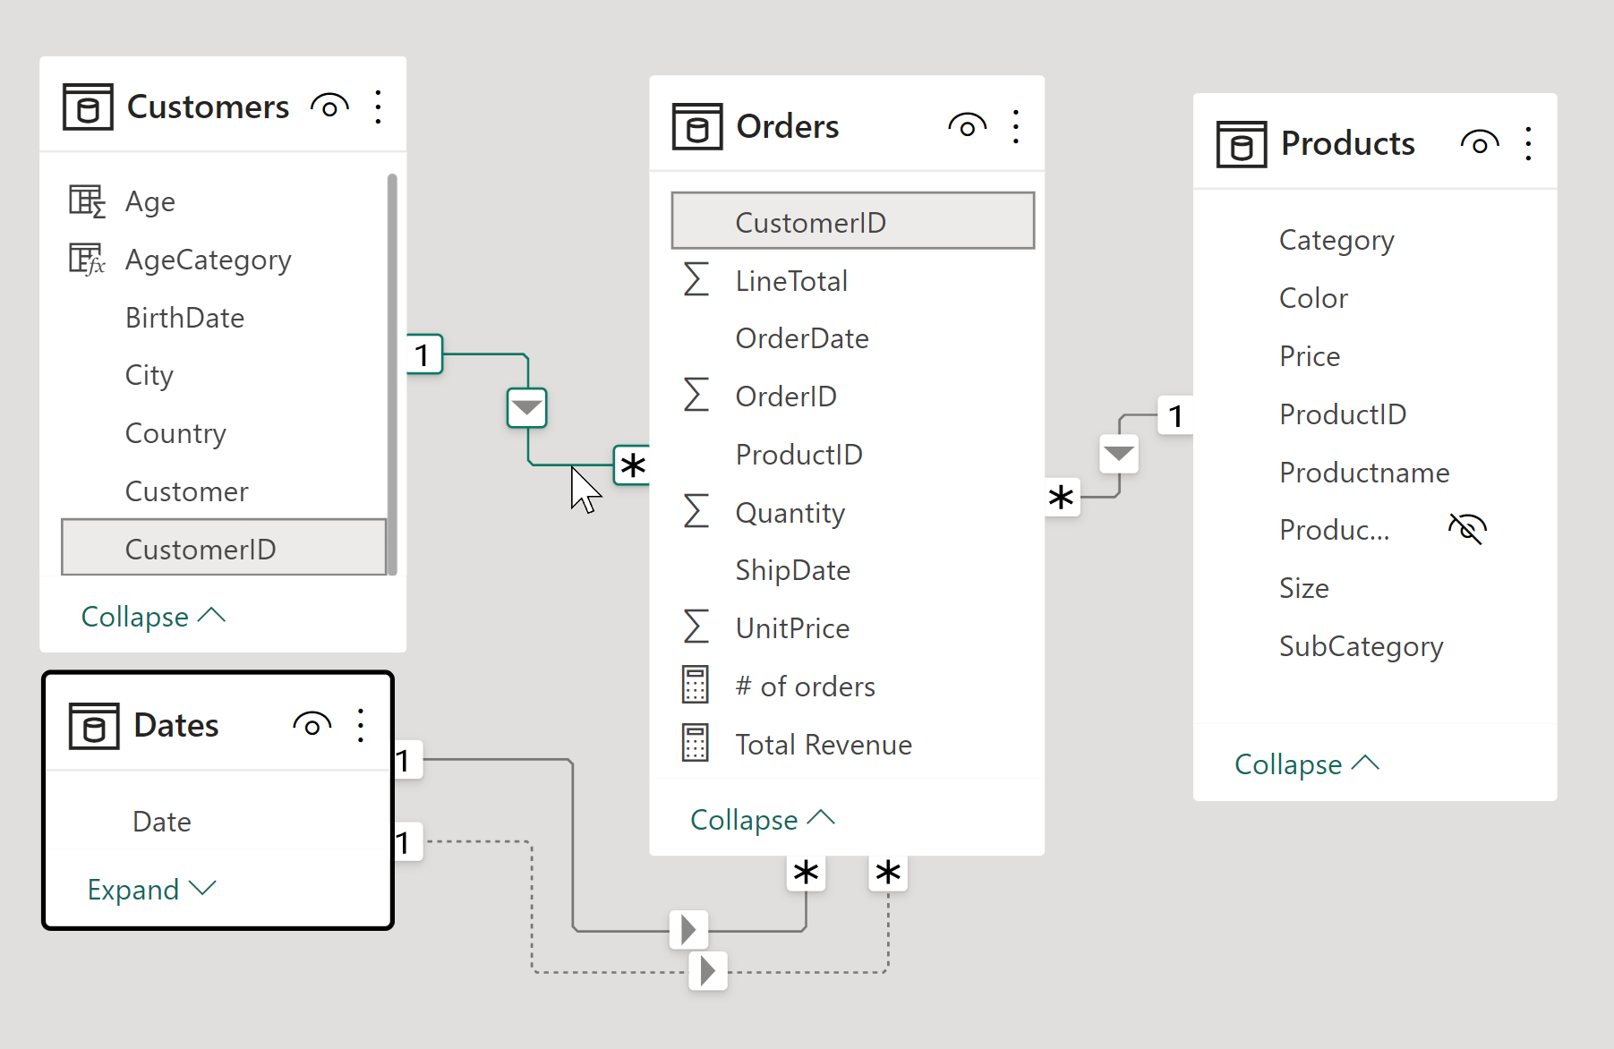
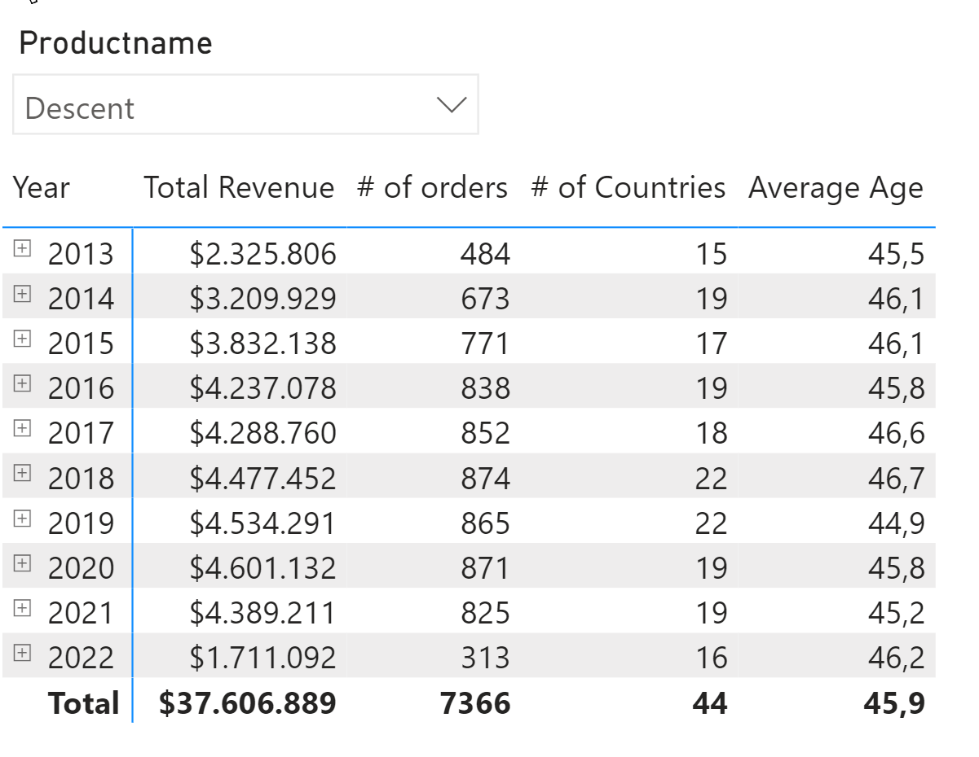
Challenge: To Bi or not to Bi
How to calculate "# of countries" and "Average age":

Slide 30
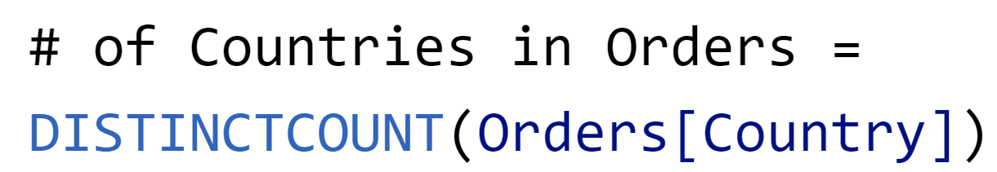
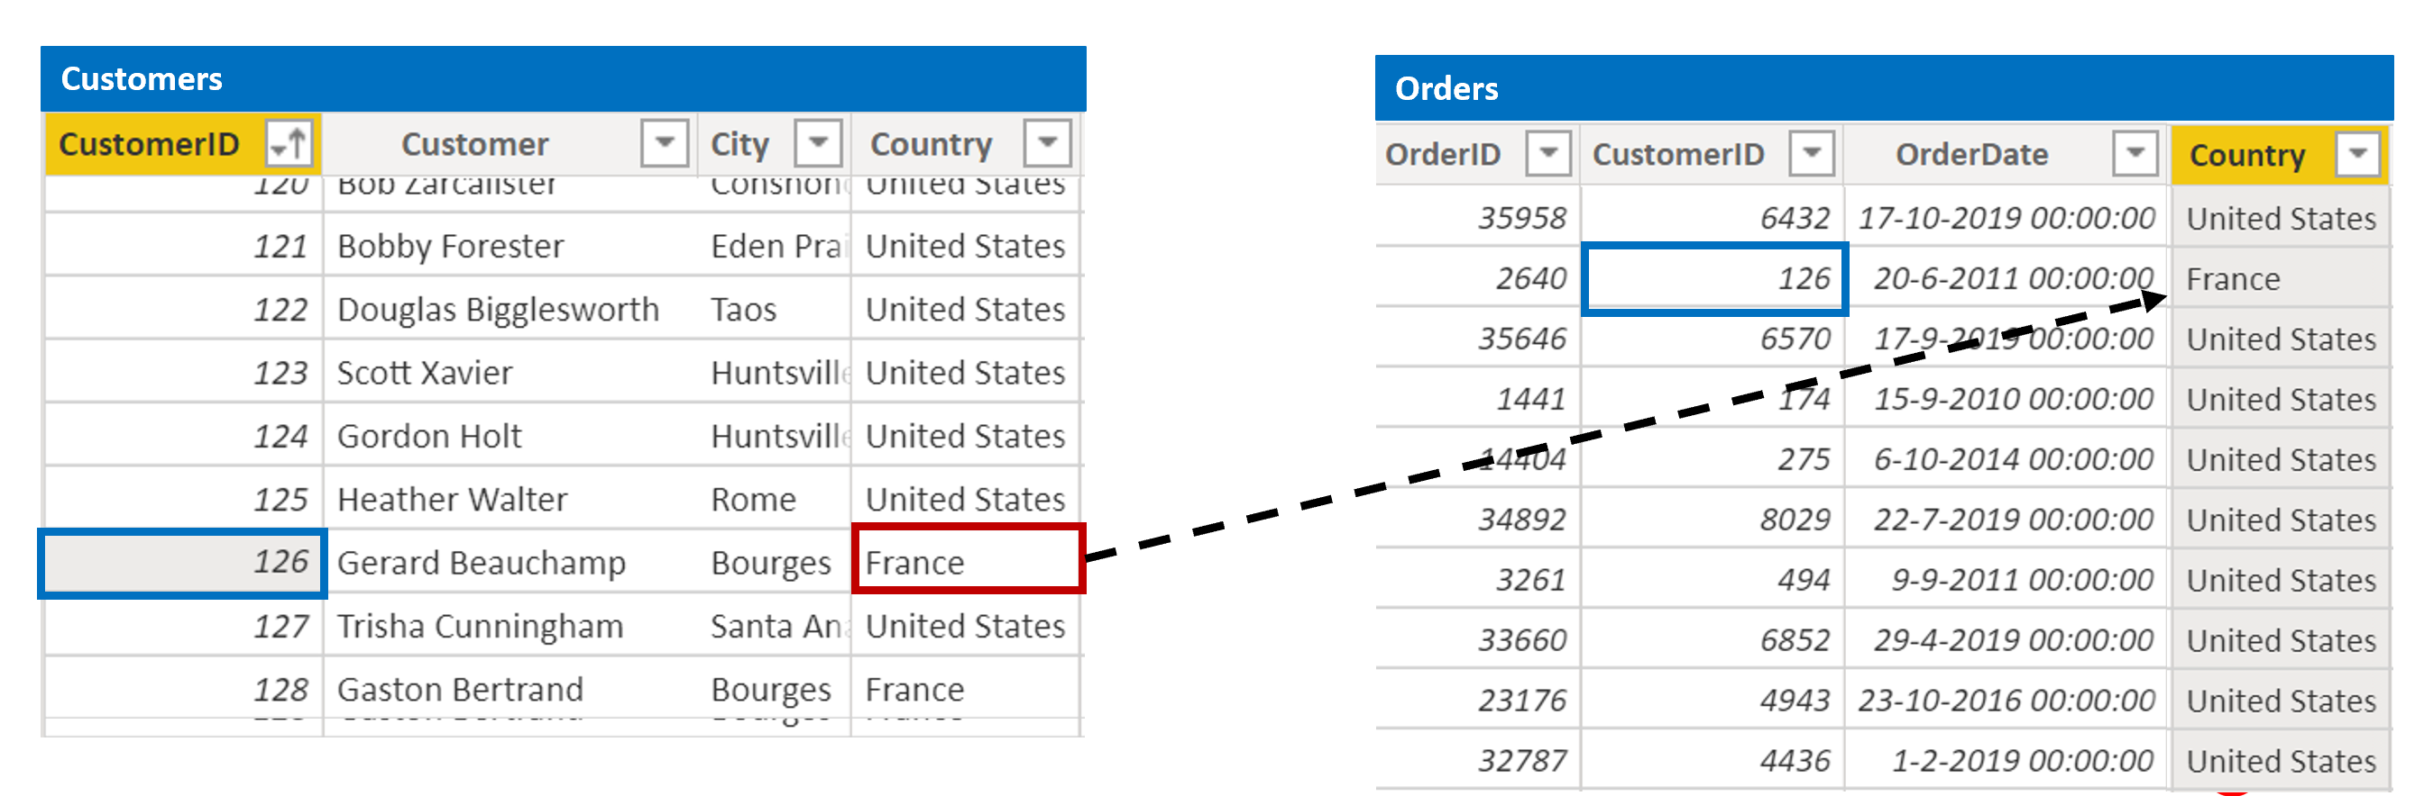
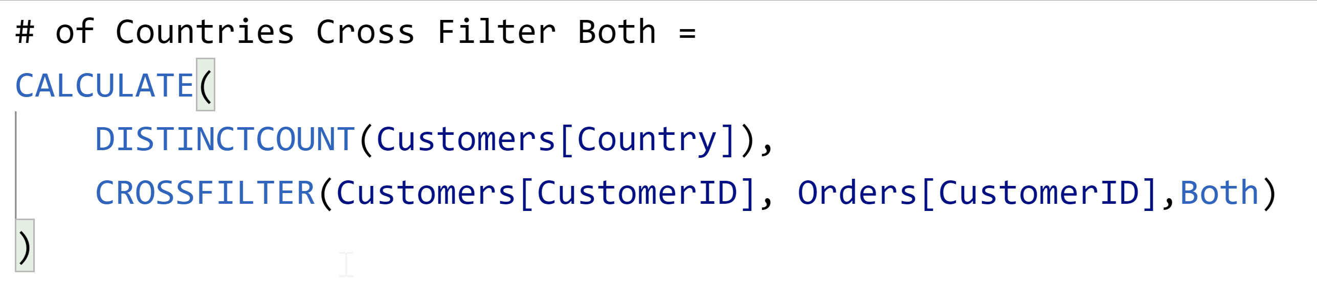
Demo – Cross Filter Direction v.s. Denormalisation
Orders[Country] = RELATED(Customers[Country])
Denormalize
Cross FIlter both

Slide 31
06 Master-Detail tables

Slide 32
Challenge: how to model multiple Master-detail tables

Slide 33
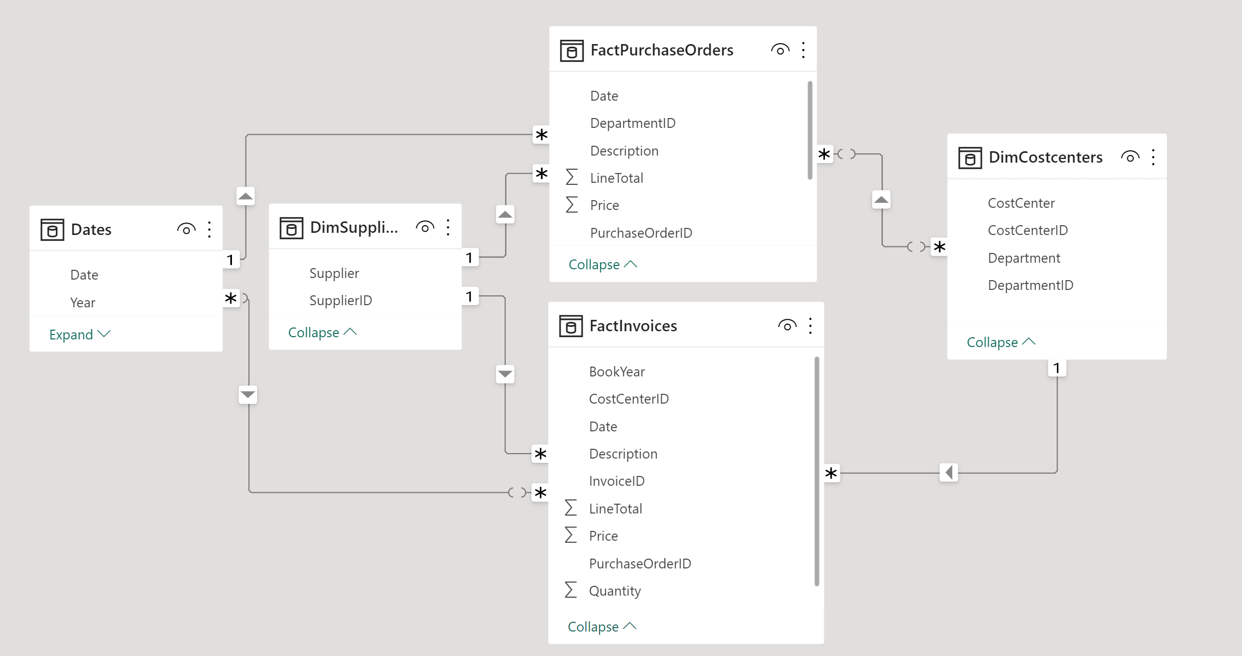
Demo: Multiple Master-Details in Star schema

Slide 34
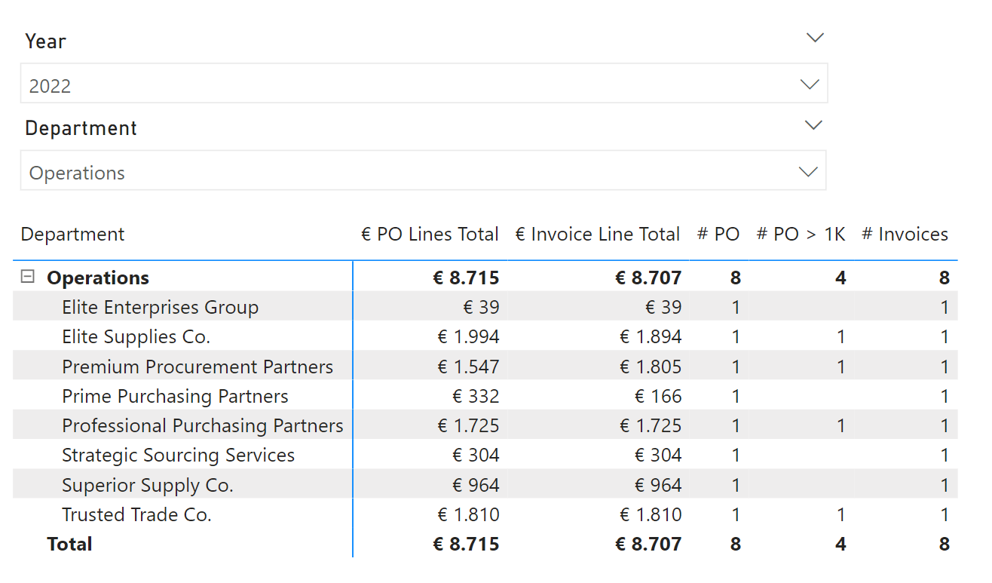
Challenge: How to calculate on Master level?

Slide 35
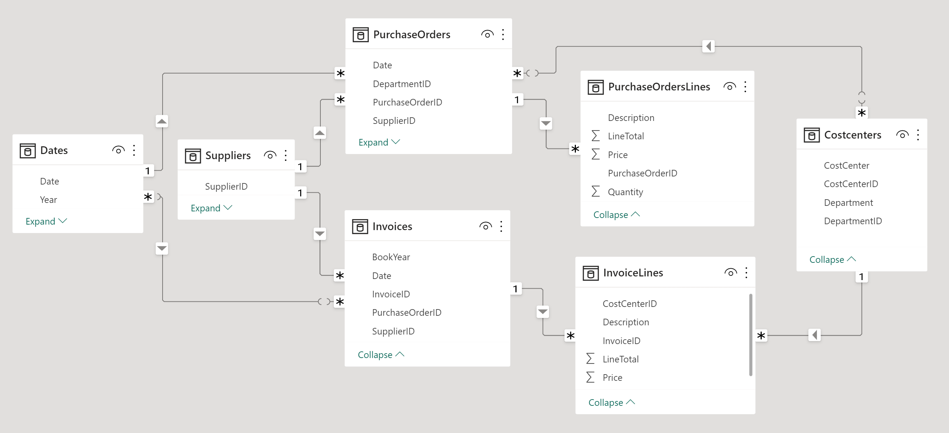
Demo: Multiple Master-Details in Relational Model

Slide 36
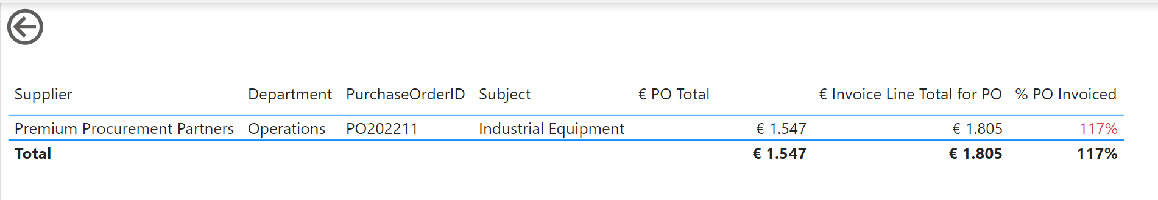
Challenge: How to connect Fact tables?

Slide 37
07 Inactive relationships

Slide 38
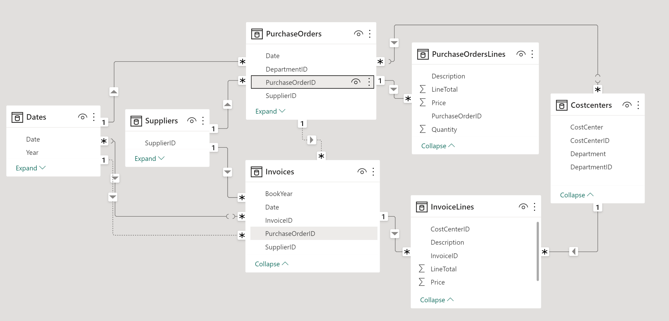
Demo: Inactive relationship – related fact tables – Master Detail

Slide 39
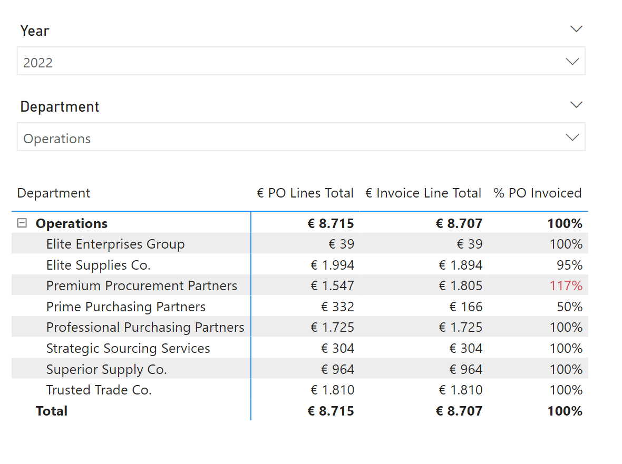
Demo: Inactive relationship – related fact tables – Master Detail

Slide 40
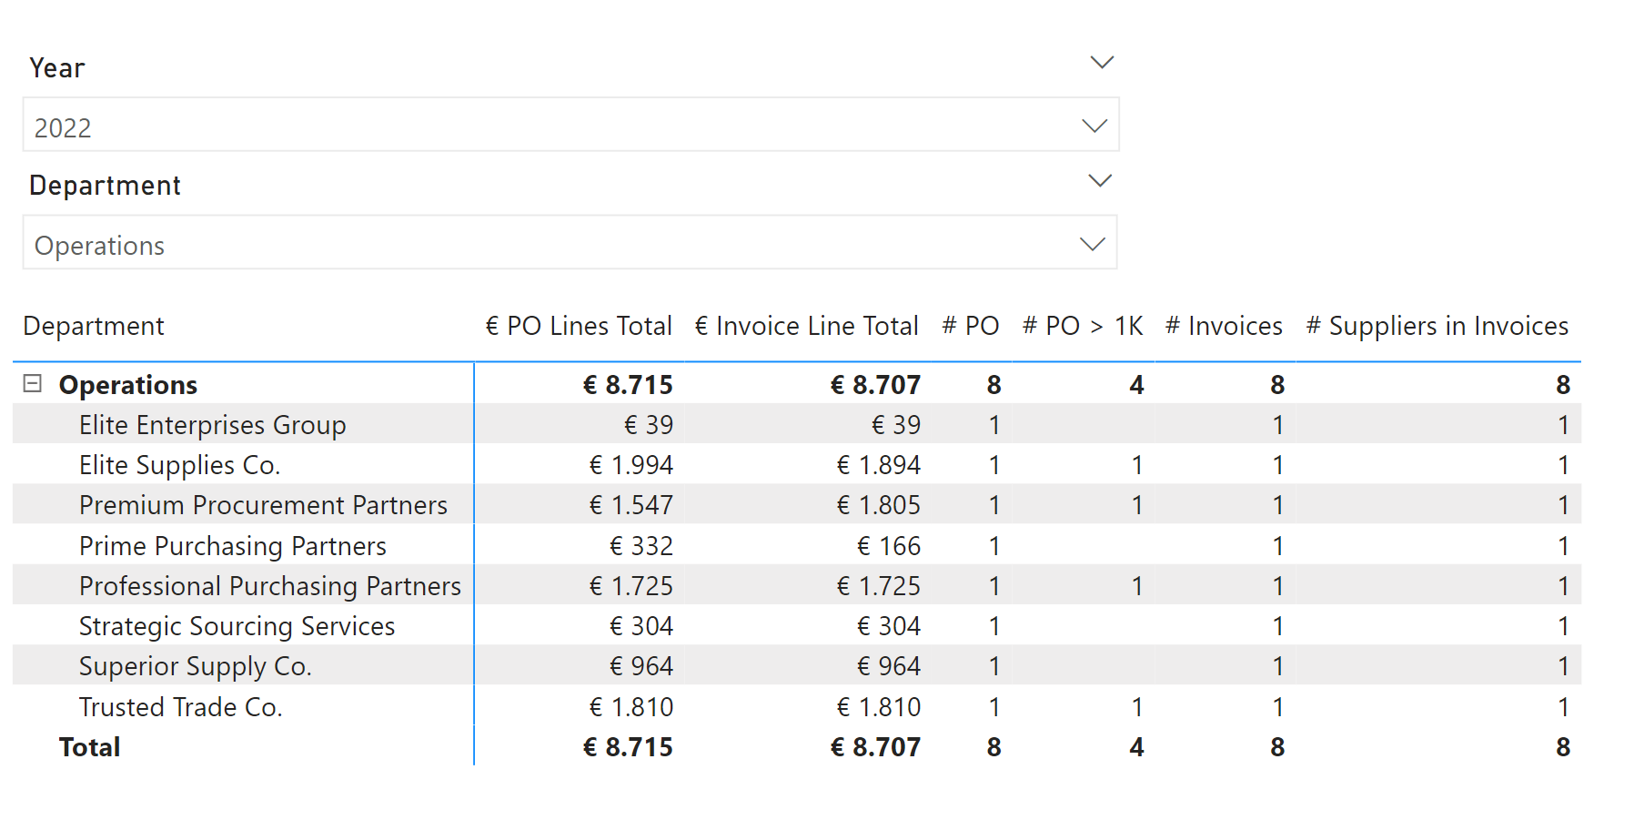
Challenge: How to calculate on Master Level?

Slide 41
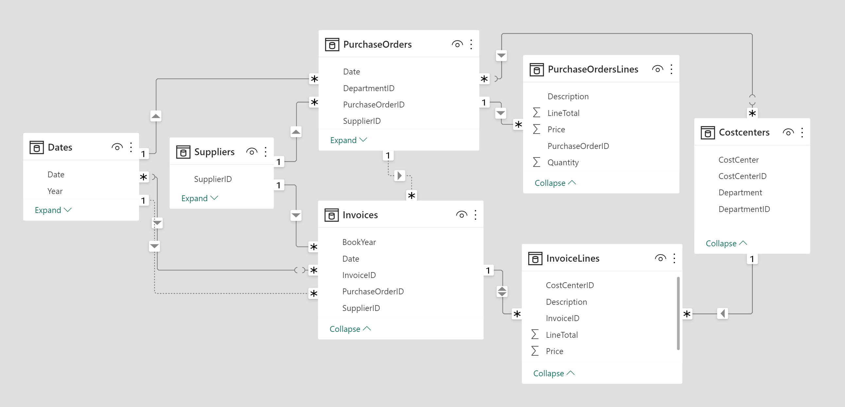
Demo: Related fact tables – Master Detail – Filter Direction

Slide 42
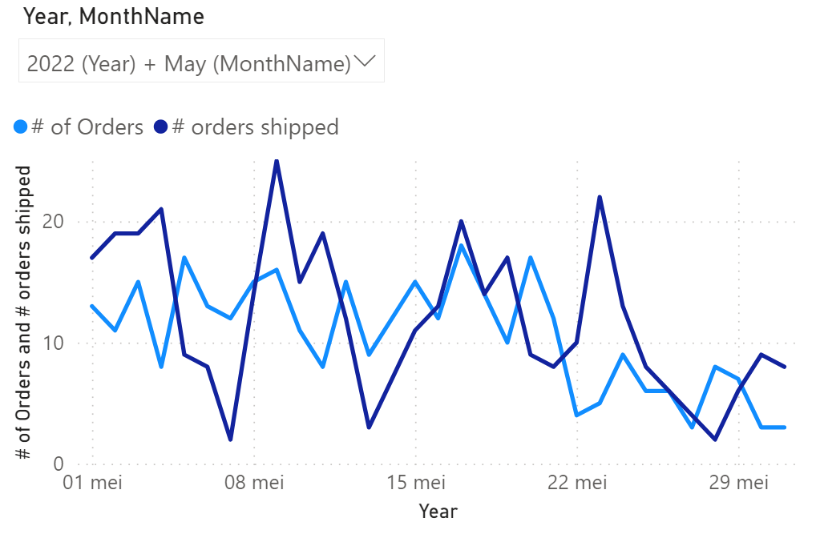
USERELATIONSHIP (Role Playing Dimensions)
# of orders = DISTINCTCOUNT( Orders[OrderID])
# of orders shipped = CALCULATE( [# of orders] , USERELATIONSHIP( Orders[ShipDate], Dates[Date] ) )

Slide 43
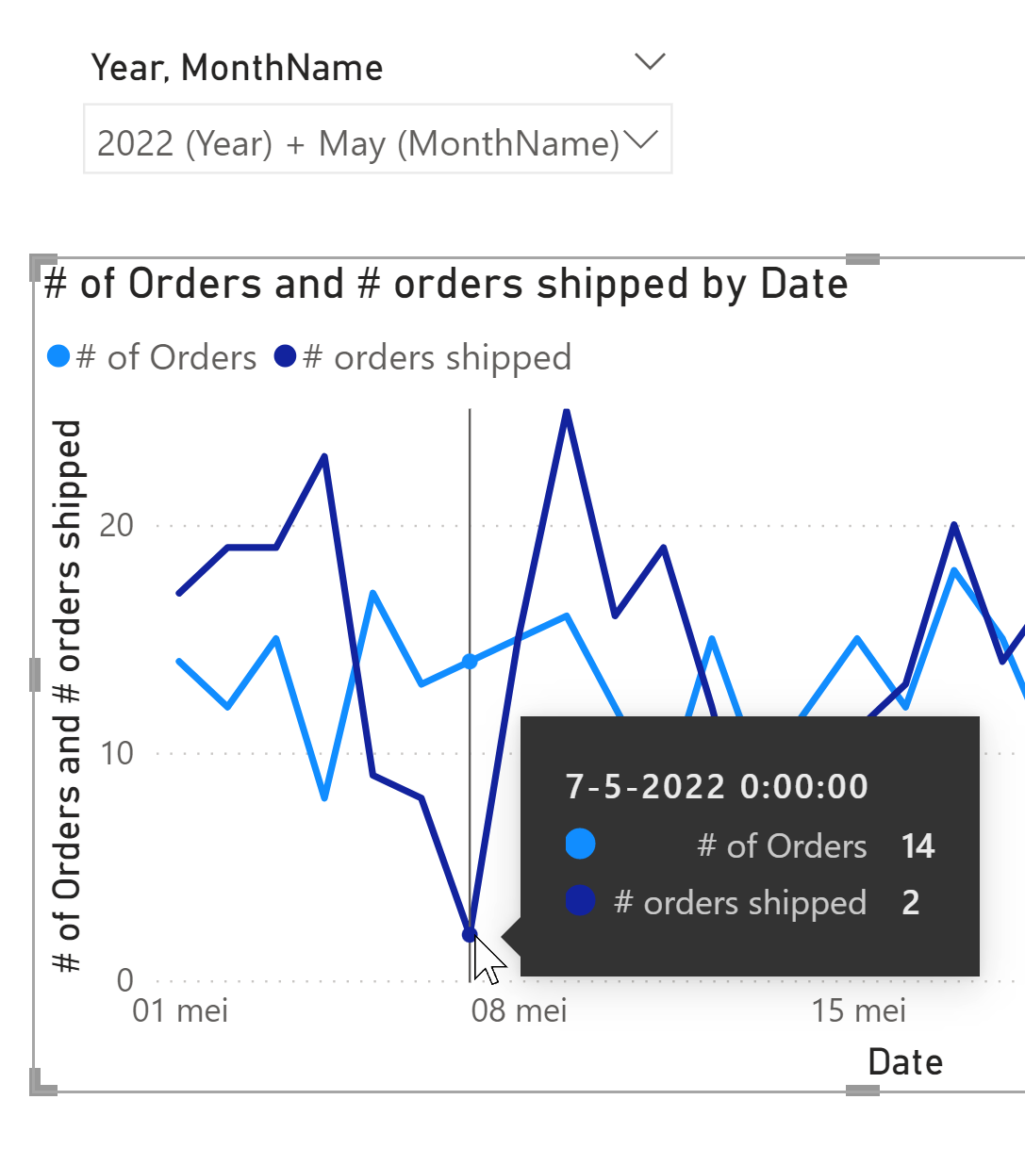
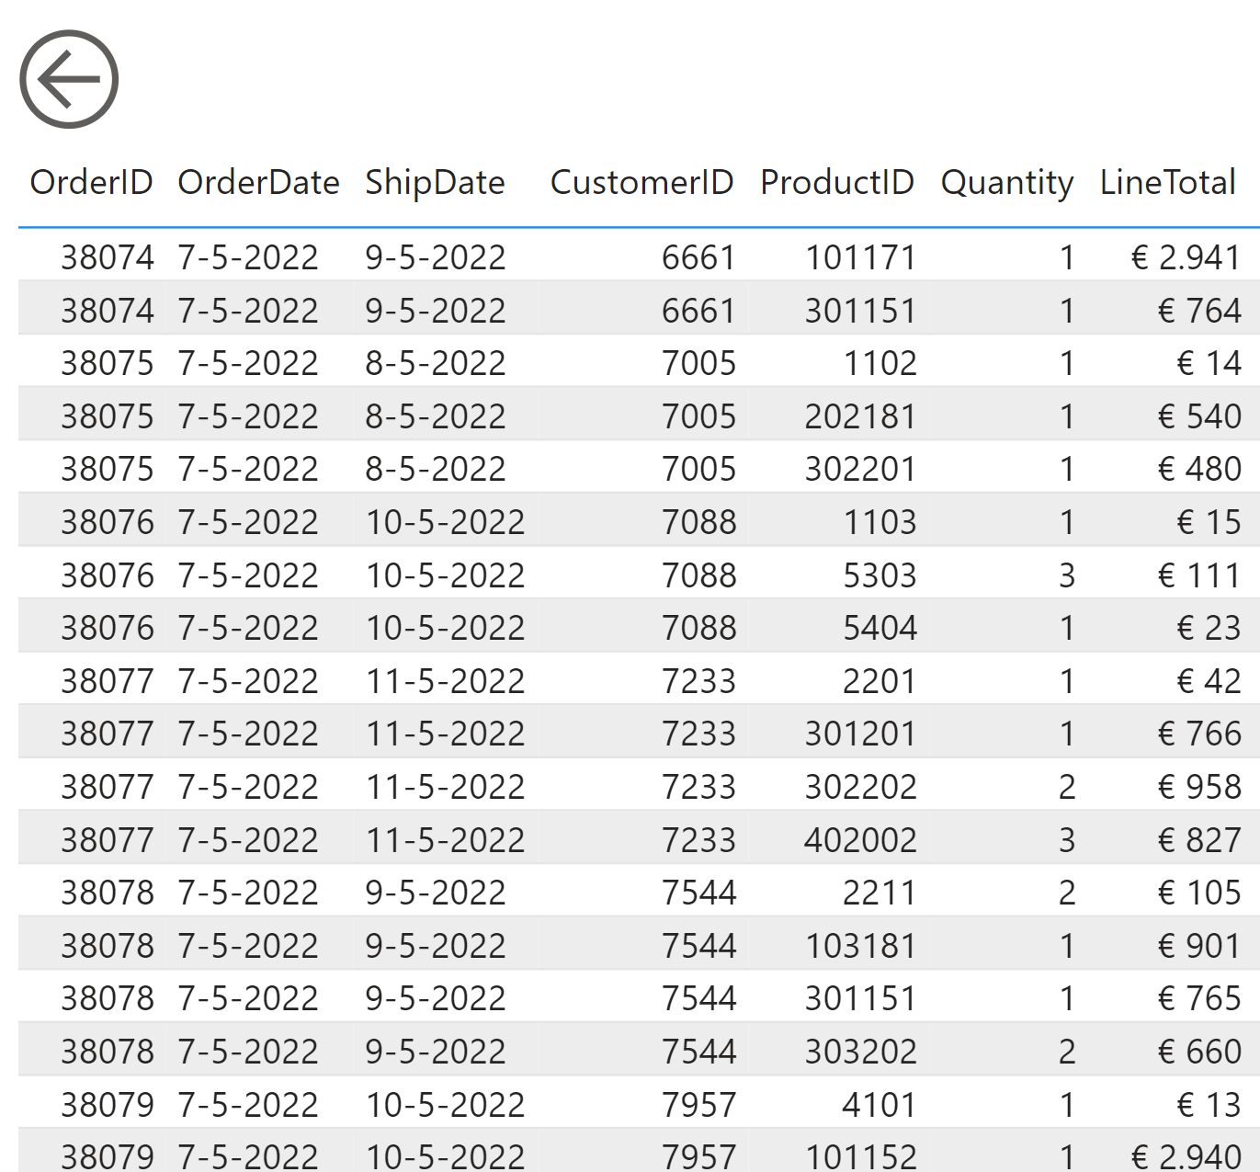

Challenge: Drill Through on Measure with USERELATIONSHIP
Drill Through Order Details Ordered
…
Drill Through Order Details Shipped

Slide 44
08 Slowly Changing Dimension

Slide 45

SCD Types:
Type 0: Changes in the source are not updated in the target.
Type 1: Changes in the source are updated in the target:
http://en.wikipedia.org/wiki/Slowly_changing_dimension

Slide 46

SCD Types:
Type 2: Changes in the source result in multiple records in the target
http://en.wikipedia.org/wiki/Slowly_changing_dimension

Slide 47




SCD Type 2 in Power BI: Snapshot exports
/
:

Slide 48


Challenge: SCD Type 2 in Power BI History tables with Start + EndDate

Slide 49



Lookup data without relationship: FILTER
FILTER(<table>, <filter>)
ProductPrices
Orders

Slide 50
09 Import v.s. direct query

Slide 51

Import Data from SQL Server: On-Premises v.s. Azure

Slide 52

Import v.s. DirectQuery

Slide 53


Demo - Direct Query for Drill through + Aggregations

Slide 54
10 Storage Engine (Vertipaq)

Slide 55
Storage Engine
Official name: xVelocity In-Memory Analytics Engine
Code name: Vertipaq
Column Storage
Good compression 1:10

Slide 56

Vertipaq Column Storage: Overview
Row Storage Column Storage

Slide 57

Vertipaq: Run Length Encoding (RLE)

Slide 58

Vertipaq: Dictionary / Hash Encoding

Slide 59

Vertipaq: Value Encoding (Whole numbers or Fixed Decimals)

Slide 60

Demo - Storage Engine - DAX Studio

Slide 61
Modelling Tips: Vertipaq
Analyze compression using DAX Studio
Remove unnecessary Columns
Disable auto Date/Time tables
Avoid High-Cardinality columns like: GUID, DateTime
Split DateTime in separate columns: Date, Hour, Minute
Create Calculated Columns in SQL Server or Power Query

Slide 62




Thank you!
Download slides, code samples + video:
https://www.arthurgraus.nl/dimensional_modelling
Questions, reach out to me:
info@arthurgraus.nl
https://www.linkedin.com/in/arthurgraus

